Slide 1
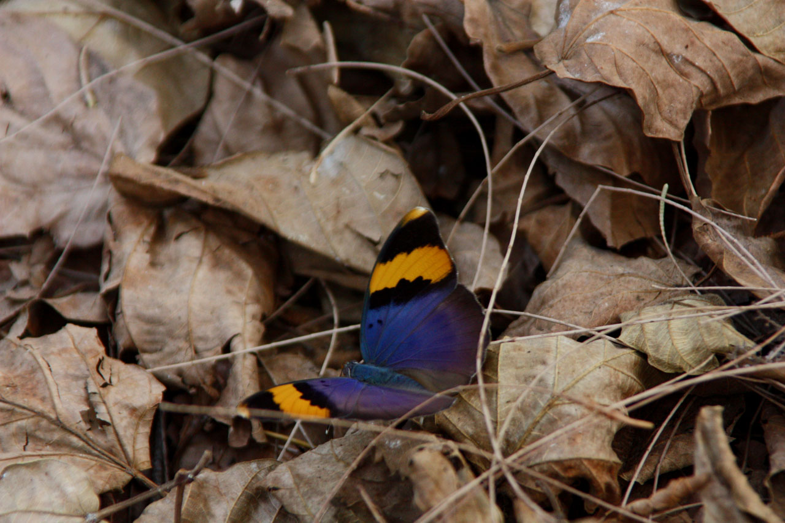
Scientific Computing
Lecture 6
Dr. Guy Tel-Zur
Butterfly in Africa by Anna Cervova , http://www.publicdomainpictures.net

Slide 2
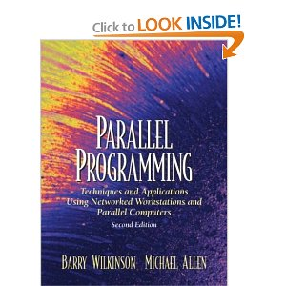
Agenda
MPI demo Mandelbrot set (again)
MPI mini-course part III: Synchronous Computations from: ITCS 4/5145 Parallel computing, UNC-Charlotte, B. Wilkinson, 2009. Chapter 6 of Wikinson&Allen’s book: Parallel Programming: Techniques and Applications Using Networked Workstations and Parallel Computers

Slide 3
Agenda
OpenMP mini-course – SC99 OpenMP tutorial:http://www.openmp.org/presentations/sc99/sc99_tutorial.pdf
Numerical case study
FlexPDE demo (if time will permit)
HPC Clouds demo on Amazon’s EC2 (if time will permit)

Slide 4
Numerical Case Study
“The Capriciousness of Numerical Methods for Singular Perturbations” by Sebastian Franz and Hans-Görg Roos, SIAM Rev. 53, pp. 157-173 (17 pages), March 2011
Available free online at: http://epubs.siam.org/sirev/resource/1/siread/v53/i1/p157_s1?bypassSSO=1
Will discuss only the first part of section 2 in the article, up to Eq. 2.6.
Notes:
Capriciousness = Characterized by or subject to whim; impulsive and unpredictable.
an inclination to sudden illogical changes of mind, ideas, or actions

Slide 5
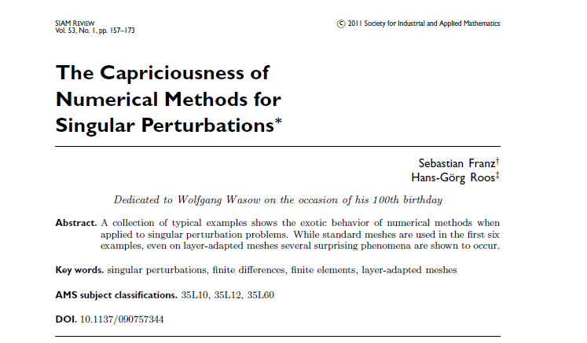

Slide 7
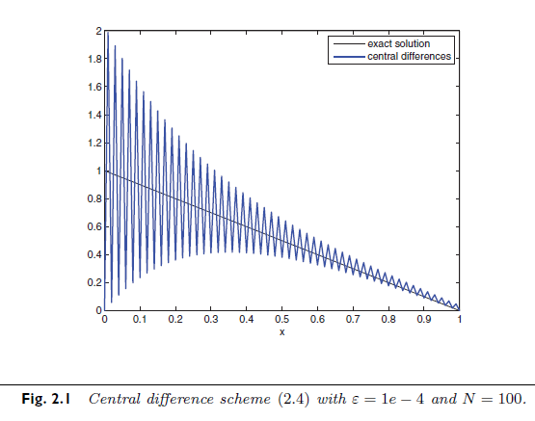

Slide 9
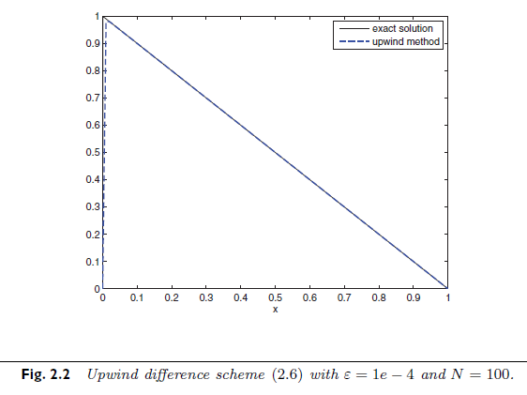

Slide 10
wasow.py, part 1/3
# -*- coding: utf-8 -*-
"""
Created on Thu Mar 17 12:04:49 2011
@author: telzur
"""
import numpy as np
from scipy.linalg import *
from scitools.all import *
#from scipy.linalg import toeplitz, inv
N=100
h=1./N
epsilon=0.0001
u=np.zeros(N)
x=np.linspace(0,1,N)
ni=h*h/epsilon
# exact
Uexact=(1.-np.exp(-x/epsilon))/(1.-np.exp(-1./epsilon))-x
# central difference
kplus=1.+h/(2*epsilon)
kminus=1.-h/(2*epsilon)
u1=np.zeros(100)
u2=np.zeros(100)

Slide 11
u1[0]=-2.
u2[0]=-2.
u1[1]=kplus
u2[1]=kminus
W=toeplitz(u2,u1) # array type, …, -49, -2, 51,…
S=inv(W)
Sm=np.mat(S.copy()) # convert an array to a matrix
I=np.ones(100)*(-ni)
Im=np.mat(I.copy()) # convert to a matrix
U=Sm*Im.transpose()
# upwind scheme
kplus=1.+h/epsilon
u1=np.zeros(100)
u2=np.zeros(100)
u1[0]=-2.-h/epsilon
u2[0]=-2.-h/epsilon
u1[1]=kplus
u2[1]=1.
W=toeplitz(u2,u1) # array type, …, 1, -102, 101, …
S=inv(W)
Sm=np.mat(S.copy()) # convert an array to a matrix
I=np.ones(100)*(-ni)
Im=np.mat(I.copy()) # convert to a matrix
wasow.py, part 2/3

Slide 12
wasow.py, part 3/3
Uupwind=Sm*Im.transpose()
# visualization and output
plot(x,array(U),'b',x,Uexact,'k')
xlabel('x')
ylabel('U')
title('Central difference scheme')
axis([0, 1, 0, 2])
show()
hardcopy('fig1.png')
figure()
plot(x,array(Uupwind),'ro',x,Uexact,'k')
xlabel('x')
ylabel('U')
title('Upwind difference scheme')
axis([0, 1, 0, 1])
show()
hardcopy('fig2.png')
foo=raw_input('Hit any key to close')
print 'done!'

Slide 13
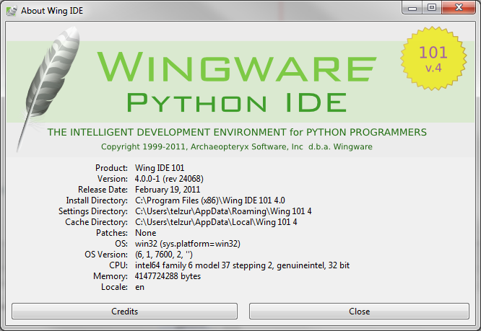
Another Python IDE
Tip: how to execute a script from the Python shell: execfile(“myscript.py”)

Slide 14
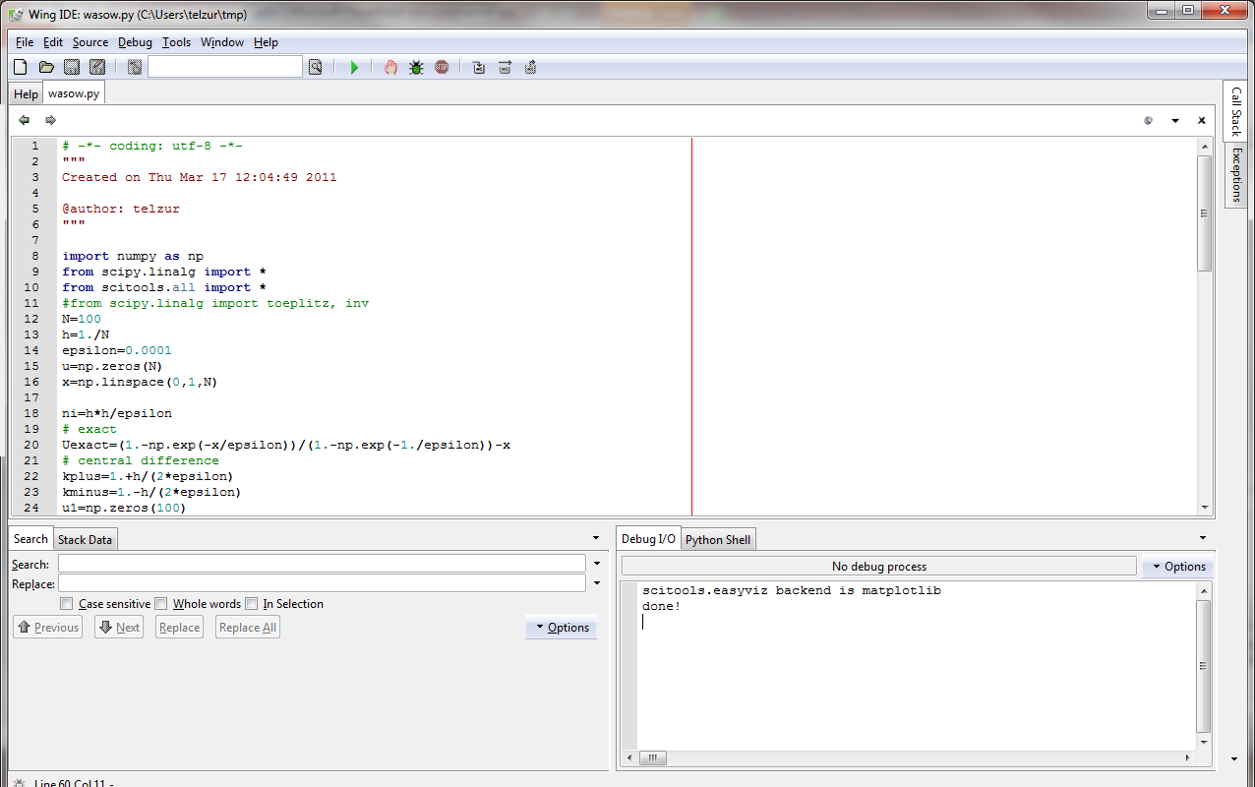
Executing the program: right click → “run in interactive mode” or open the IDE and click on F5

Slide 15
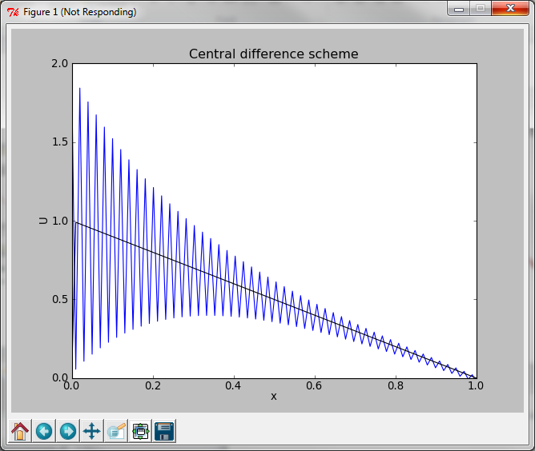

Slide 16
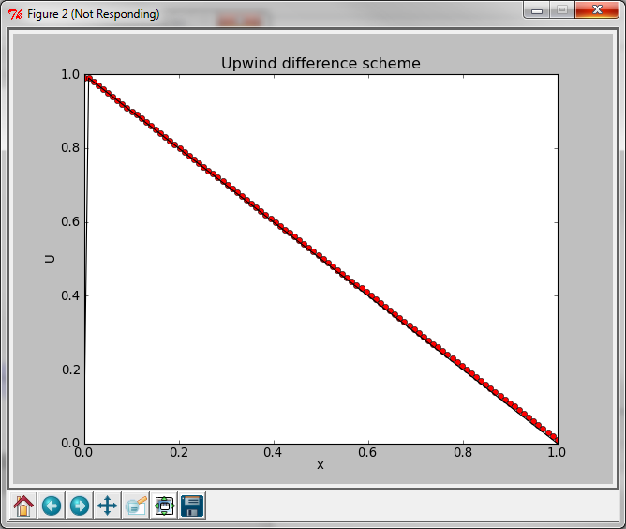

Slide 17
Tips
Microsoft Mathematics

Slide 18
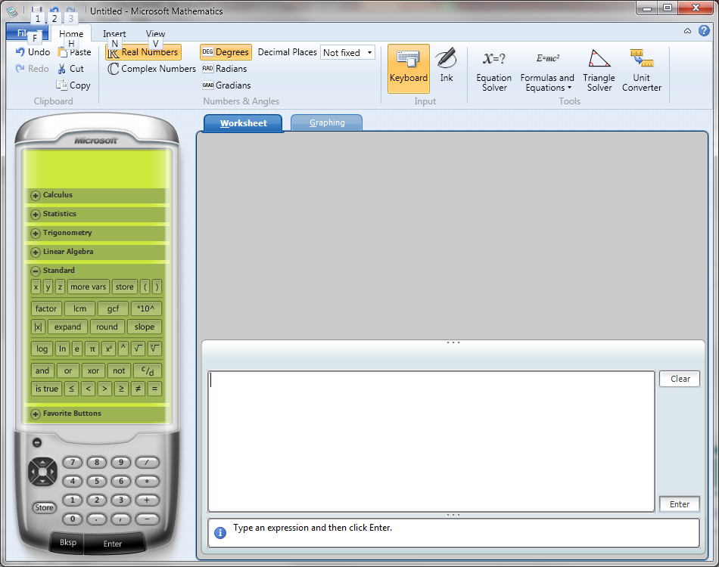

Slide 19
Proceed to MPI / Chapter 6
Then, OpenMP SC99 Tutorial

