Slide 1
Scientific Computing Random walks and the Metropolis algorithm
Dr. Guy Tel-Zur
Forest In Fog by giovanni neri http://www.publicdomainpictures.net version 02-12-2010, 15:00

Slide 2
Diffusion Equation
j(x, t) = The flux of particles.
w(x, t)dx is the probability of finding a given number of particles in an interval of length dx in x ∈ [x, x+dx] at a time t. It is the PDF.

Slide 4
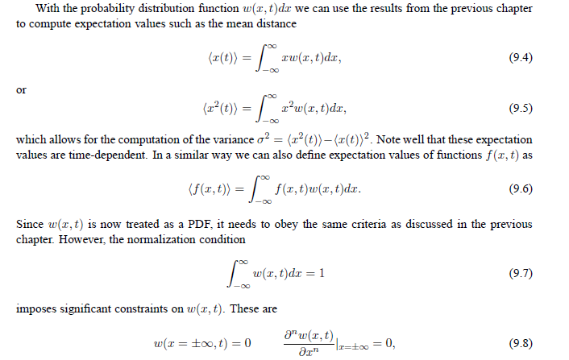

Slide 5
This means in turn that <x> is independent of time!
This reminds us a random walk in 1D
What about the variance of x?

Slide 6
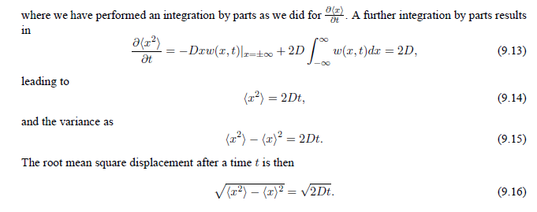

Slide 7
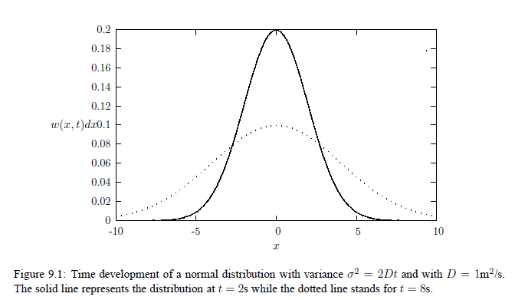

Slide 8
Random walks

Slide 9
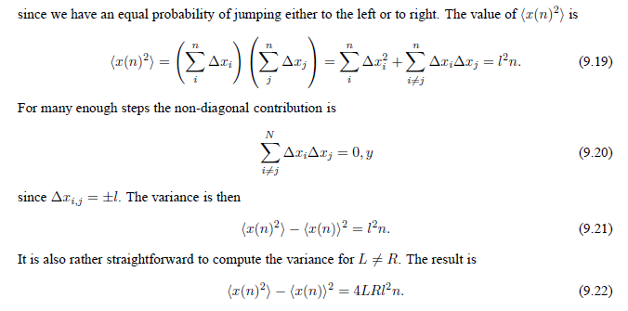

Slide 10
Demo: computer code: Open DevC++ execute a modified “program1.cpp”

Slide 11
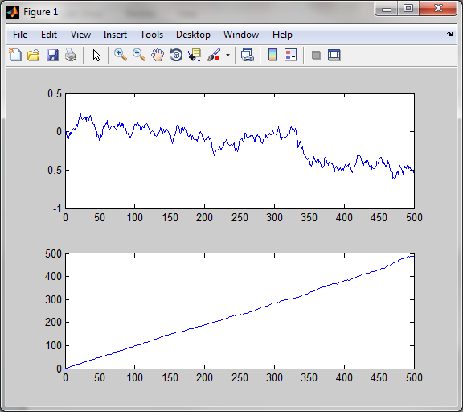
Matlab:
a=load(‘testwalkers.dat’)
plot(a(:,1),a(:,2))
plot(a(:,1),a(:,3))
subplot(2,1,1),plot(a(:,1),a(:,2))
subplot(2,1,2),plot(a(:,1),a(:,3))
<X>
variance

Slide 12
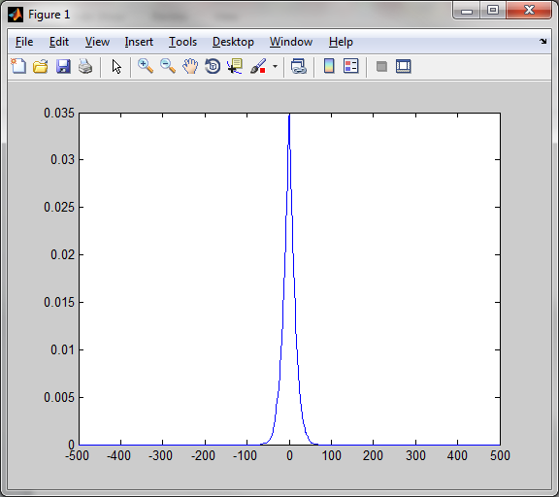
Matlab:
p=load(‘probability.dat’)
plot(p(:1,),p(:,2))

Slide 14
The Metropolis algorithm and detailed balance
The Best of the 20th Century: Editors Name Top 10 Algorithms
SIAM News, Volume 33, Number 4
By Barry A. Cipra
1946: John von Neumann, Stan Ulam, and Nick Metropolis, all at the Los Alamos Scientific Laboratory, cook up the Metropolis
algorithm, also known as the Monte Carlo method.
The Metropolis algorithm aims to obtain approximate solutions to numerical problems with unmanageably many degrees of freedom
and to combinatorial problems of factorial size, by mimicking a random process. Given the digital computer’s reputation for
deterministic calculation, it’s fitting that one of its earliest applications was the generation of random numbers.

Slide 15
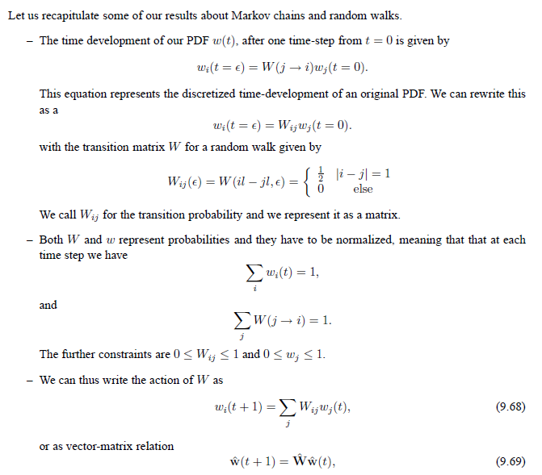

Slide 16
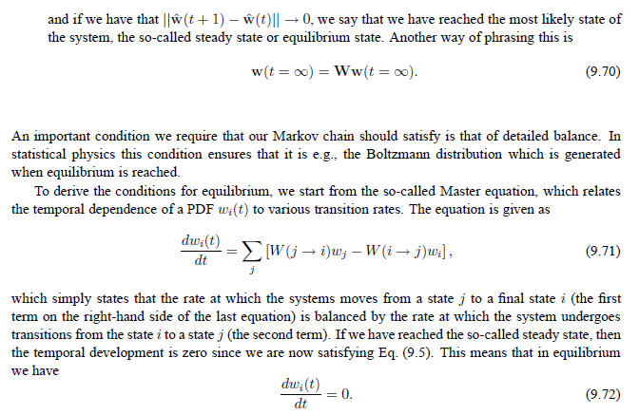

Slide 17
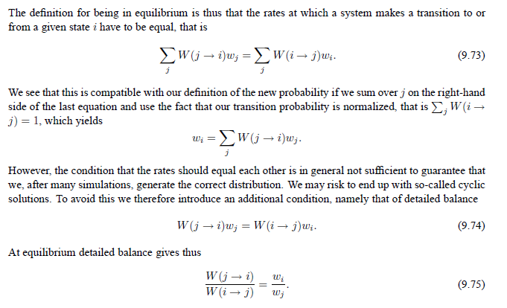

Slide 18
קושי לחשב את פונ' החלוקה

Slide 20
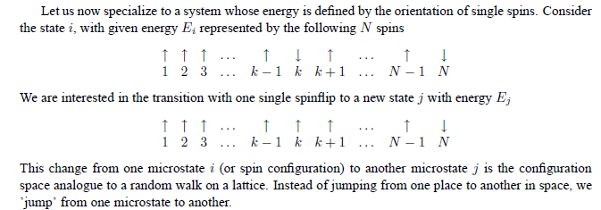

Slide 22
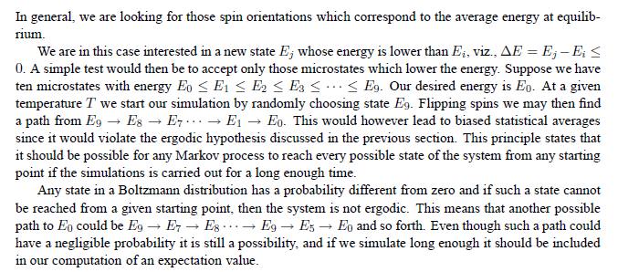

Slide 23
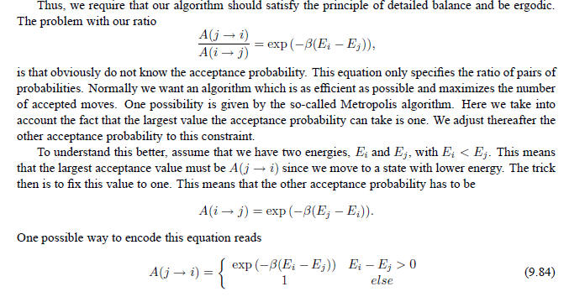

Slide 25
