Slide 1
Scientific Computing Monte Carlo Computations
Dr. Guy Tel-Zur
John Edwards, Seaford Yachts, http://www.publicdomainpictures.net

Slide 2
MHJ Chapter 8

Slide 3
Probability Distribution Function (PDF)
The relation between a CDF and its corresponding PDF is then:

Slide 4
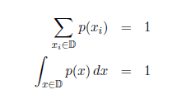
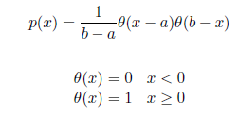
The PDF must satisfy two conditions
Normalization
An example: The Uniform distribution
An example: The Normal distribution

Slide 5
Expectation value:
N-th moment:
The zero-th moment is called the mean
The n-th central moment:

Slide 6
The second central moment is the variance:
The standard deviation of p:

Slide 7
Higher moments
Any odd moment about the mean is a measure of the skewness of the p.d.f. The
simplest of these is the dimensionless coefficient of skewness γ1 = m3/σ3
The fourth central moment m4 provides a convenient measure of the tails of a
distribution. For the Gaussian distribution one has m4 = 3σ^4. The
kurtosis is defined as γ2 = m4/σ^4 − 3, i.e., it is zero for a Gaussian, positive for a
leptokurtic distribution with longer tails, and negative for a platykurtic distribution with tails that die off more quickly than those of a Gaussian.
Skewness = צידוד
מדד לחוסר הסימטריה של ההתפלגות

Slide 8
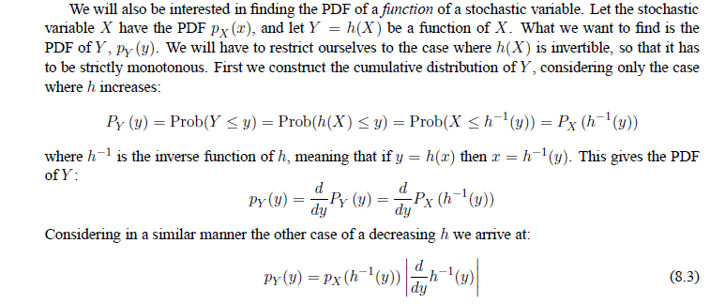
The PDF of a function of a stochastic variable

Slide 9
Integration
rectangles
b=1, a=0

Slide 10
For a uniform distribution of x between 0 and 1
What about the variance of f in the range 0..1 ?

Slide 11
Example - 1 (1 out of 3)
#include <cmath>
#include <iostream>
///// #include "lib.h"
#include <stdlib.h> // added by Guy
using namespace std;
// Here we define various functions called by the main program
// this function defines the function to integrate
double func(double x);
// Main function begins here
int main()
{
int i, n;
long idum;
double crude_mc, x, sum_sigma, fx, variance, exact;
printf("Read in the number of Monte-Carlo samples\n");
scanf("%d", &n);
crude_mc = sum_sigma=0. ; idum=-1 ; exact=acos(-1.);
printf("RAND_MAX=%d",RAND_MAX);
printf(" rand %f \n",double(rand())/double(RAND_MAX));
printf(" rand %f \n",double(rand())/double(RAND_MAX));
printf(" rand %f \n",double(rand())/double(RAND_MAX));
printf(" rand %f \n",double(rand())/double(RAND_MAX));
Show in DevC++ IDE
07/code/program1.cpp
Pseudo-Random number generator on GNU C: http://www.gnu.org/s/libc/manual/html_node/ISO-Random.html#ISO-Random

Slide 12
Example - 1 (2 out of 3)
// evaluate the integral with a crude Monte-Carlo method
for ( i = 1; i <= n; i++){
// x=ran0(&idum);
x=double(rand())/double(RAND_MAX); // added by Guy
fx=func(x);
crude_mc += fx;
sum_sigma += fx*fx;
}
crude_mc = crude_mc/((double) n );
sum_sigma = sum_sigma/((double) n );
variance=sum_sigma-crude_mc*crude_mc;
// final output
printf("%d variance= %12.5E Inum= %12.5E pi= %12.5E\n", n, variance, crude_mc, exact);
return 0;
} // end of main program
// this function defines the function to integrate
double func(double x)
{
double value;
value = 4/(1.+x*x);
return value;
} // end of function to evaluate

Slide 13
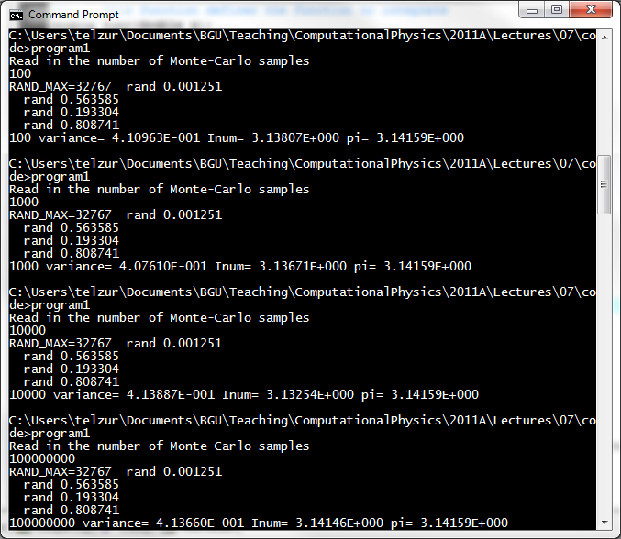
Example - 1 (3 out of 3)
Show “program1.cpp” for calculating pi

Slide 14
Example -2, Radioactive decay
Slide 1 out of 5
// Radioactive decay of nuclei
#include <iostream>
#include <fstream>
#include <iomanip>
// #include "lib.h" // commented out by Guy
#include <stdlib.h> // added by Guy
using namespace std;
ofstream ofile;
// Function to read in data from screen
void initialise(int&, int&, int&, double& ) ;
// The MC sampling for nuclear decay
void mc_sampling(int, int, int, double, int*);
// prints to screen the results of the calculations
void output(int, int, int *);

Slide 15
Example -2, Radioactive decay
Slide 2 out of 5
int main(int argc, char* argv[])
{
char *outfilename;
int initial_n_particles, max_time, number_cycles;
double decay_probability;
int *ncumulative;
// Read in output file, abort if there are too few command-line arguments
if( argc <= 1 ){
cout << "Bad Usage: " << argv[0] <<
" read also output file on same line" << endl;
exit(1);
}
else{
outfilename=argv[1];
}
ofile.open(outfilename);
// Read in data
initialise(initial_n_particles, max_time, number_cycles,
decay_probability) ;
ncumulative = new int [max_time+1];

Slide 16
Example -2, Radioactive decay
Slide 3 out of 5
// Do the mc sampling
mc_sampling(initial_n_particles, max_time, number_cycles,
decay_probability, ncumulative);
// Print out results
output(max_time, number_cycles, ncumulative);
delete [] ncumulative;
return 0;
}
void initialise(int& initial_n_particles, int& max_time, int& number_cycles, double& decay_probability)
{
cout << "Initial number of particles = " << endl ;
cin >> initial_n_particles;
cout << "maximum time = " << endl;
cin >> max_time;
cout << "# MC steps= " << endl;
cin >> number_cycles;
cout << "# Decay probability= " << endl;
cin >> decay_probability;
} // end of function initialise

Slide 17
Example -2, Radioactive decay
Slide 4 out of 5
void output(int max_time, int number_cycles, int* ncumulative)
{
int i;
for( i=0; i <= max_time; i++){
ofile << setiosflags(ios::showpoint | ios::uppercase);
ofile << setw(15) << i;
ofile << setw(15) << setprecision(8);
ofile << ncumulative[i]/((double) number_cycles) << endl;
}
} // end of function output

Slide 18
void mc_sampling(int initial_n_particles, int max_time, int number_cycles, double decay_probability, int *ncumulative)
{
int cycles, time, np, n_unstable, particle_limit;
long idum;
double x;
idum=-1; // initialise random number generator
// loop over monte carlo cycles
// One monte carlo loop is one sample
for (cycles = 1; cycles <= number_cycles; cycles++){
n_unstable = initial_n_particles;
// accumulate the number of particles per time step per trial
ncumulative[0] += initial_n_particles;
// loop over each time step
for (time=1; time <= max_time; time++){
// for each time step, we check each particle
particle_limit = n_unstable;
for ( np = 1; np <= particle_limit; np++) {
// if( ran0(&idum) <= decay_probability) {
x=double(rand())/double(RAND_MAX); // added by Guy
if( x <= decay_probability) {
n_unstable=n_unstable-1;
}
} // end of loop over particles
ncumulative[time] += n_unstable;
} // end of loop over time steps
} // end of loop over MC trials
} // end mc_sampling function
Slide 5 out of 5

Slide 19
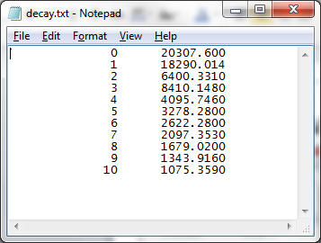
Program3 execution
C:\Users\telzur\Documents\BGU\Teaching\ComputationalPhysics\2011A\Lectures\07\co
de>program3 decay.txt
Initial number of particles =
10000
maximum time =
10
# MC steps=
1000
# Decay probability=
0.2
The output file

Slide 20
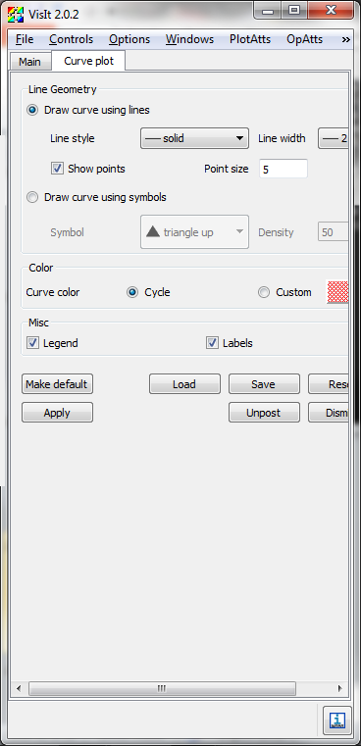
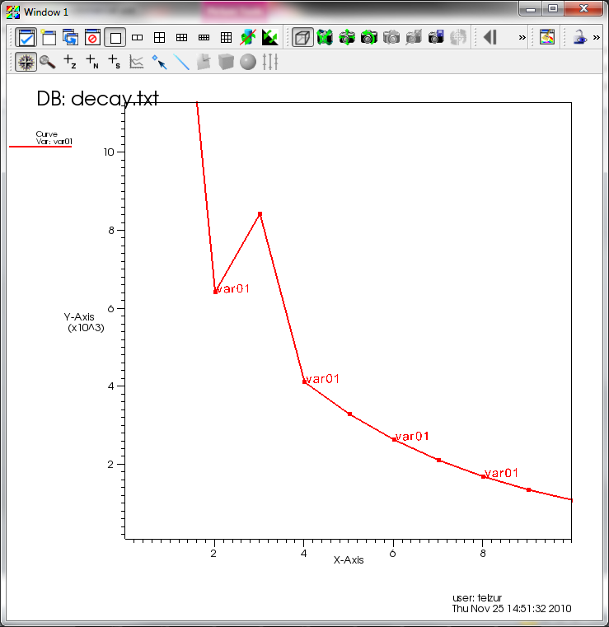
Output visualization using VisIt

Slide 21
Gaussian Distribution
#include <cmath>
#include <iostream>
///// #include "lib.h"
#include <stdlib.h> // added by Guy
#include <fstream>
#include <iomanip>
using namespace std;
int main(int argc, char* argv[])
{
int i, n;
double pi=3.14159265358979;
long idum;
double crude_mc, x,y,x1,x2,radius,theta, sum_sigma, fx, variance, exact;
char *outfilename;
printf("Read in the number of Monte-Carlo samples\n");
scanf("%d", &n);
ofstream ofile;
outfilename=argv[1];
ofile.open(outfilename);
for ( i = 1; i <= n; i++){
// x=ran0(&idum);
x1=double(rand())/double(RAND_MAX); // added by Guy
x2=double(rand())/double(RAND_MAX); // added by Guy
theta = 2 * pi * x2;
radius = sqrt(-2*log(1-x1));
x=radius * cos(theta);
y=radius * sin(theta);
// printf("%12.5E %12.5E\n", x, y);
ofile << x << " " << y << endl;;
}
return 0;
} // end of main program

Slide 22
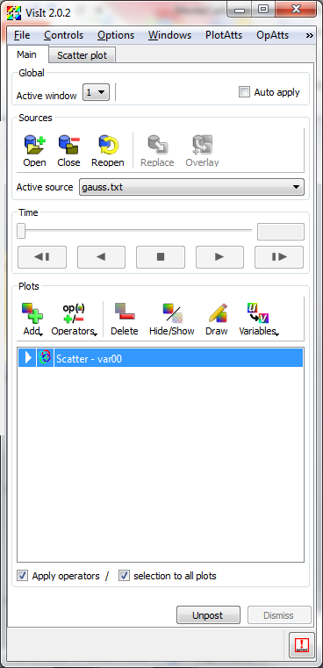
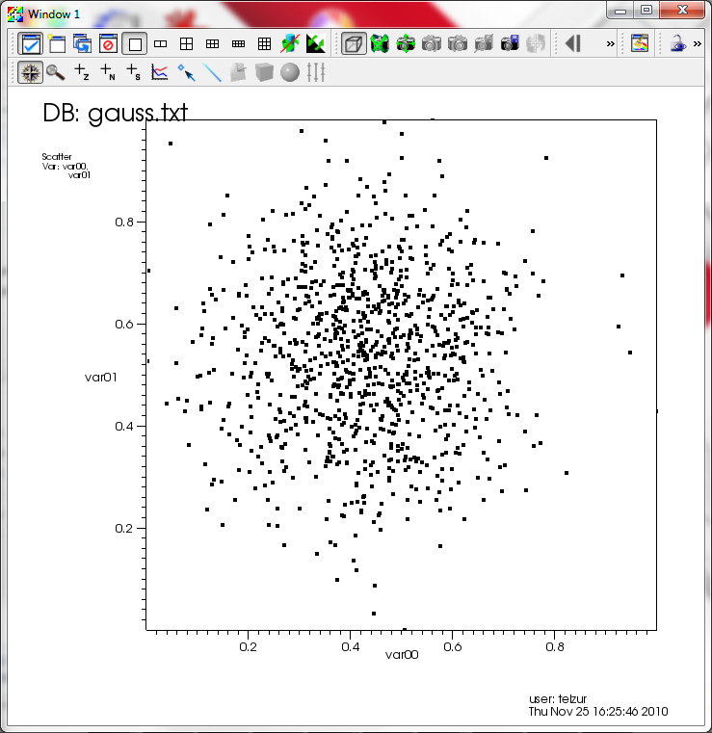
Gaussian Distribution

Slide 23
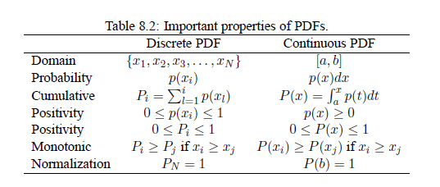

Slide 24
Probability

Slide 25
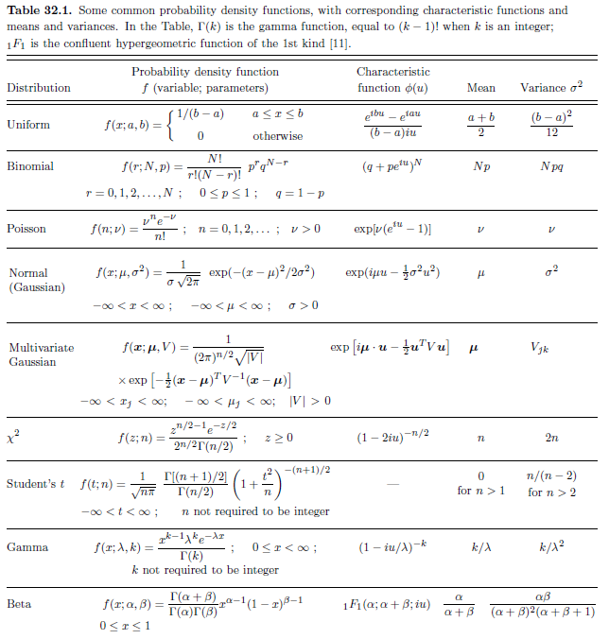
Source: PDG - Particle Data Group

Slide 26
Matlab
If you have the statistics package you can try:
disttool
randtool

Slide 27
Fitting Example
Use CERN’s root
An Example: FittingDemo.C under: C:\root\tutorials\fit
Code and plots on the next slides
Lorentzian (Cauchy’s distribution function)
http://en.wikipedia.org/wiki/Cauchy_distribution

Slide 28
//Example for fitting signal/background.
// This example can be executed with:
// root > .x FittingDemo.C (using the CINT interpreter)
// root > .x FittingDemo.C+ (using the native complier via ACLIC)
//Author: Rene Brun
// comments added by Guy:
#include "TH1.h“ // 1D histograms
#include "TMath.h“ // math functions
#include "TF1.h“ // 1D fitting
#include "TLegend.h“ // graphics
#include "TCanvas.h“ // graphics
// Quadratic background function
Double_t background(Double_t *x, Double_t *par) {
return par[0] + par[1]*x[0] + par[2]*x[0]*x[0];
}
// Lorenzian Peak function
Double_t lorentzianPeak(Double_t *x, Double_t *par) {
return (0.5*par[0]*par[1]/TMath::Pi()) /
TMath::Max( 1.e-10,(x[0]-par[2])*(x[0]-par[2])
+ .25*par[1]*par[1]);
}
Slide 1 out of 4

Slide 29
// Sum of background and peak function
Double_t fitFunction(Double_t *x, Double_t *par) {
return background(x,par) + lorentzianPeak(x,&par[3]);
}
void FittingDemo() {
//Bevington Exercise by Peter Malzacher, modified by Rene Brun
const int nBins = 60;
Double_t data[nBins] = { 6, 1,10,12, 6,13,23,22,15,21,
23,26,36,25,27,35,40,44,66,81,
75,57,48,45,46,41,35,36,53,32,
40,37,38,31,36,44,42,37,32,32,
43,44,35,33,33,39,29,41,32,44,
26,39,29,35,32,21,21,15,25,15};
TCanvas *c1 = new TCanvas("c1","Fitting Demo",10,10,700,500);
c1->SetFillColor(33);
c1->SetFrameFillColor(41);
c1->SetGrid();
TH1F *histo = new TH1F("histo", "Lorentzian Peak on Quadratic Background",60,0,3);
histo->SetMarkerStyle(21);
histo->SetMarkerSize(0.8);
histo->SetStats(0);
Slide 2 out of 4

Slide 30
Slide 3 out of 4
for(int i=0; i < nBins; i++) histo->SetBinContent(i+1,data[i]);
// create a TF1 with the range from 0 to 3 and 6 parameters
TF1 *fitFcn = new TF1("fitFcn",fitFunction,0,3,6);
fitFcn->SetNpx(500);
fitFcn->SetLineWidth(4);
fitFcn->SetLineColor(kMagenta);
// first try without starting values for the parameters
// This defaults to 1 for each param.
// this results in an ok fit for the polynomial function
// however the non-linear part (lorenzian) does not
// respond well.
fitFcn->SetParameters(1,1,1,1,1,1);
histo->Fit("fitFcn","0");
// second try: set start values for some parameters
fitFcn->SetParameter(4,0.2); // width
fitFcn->SetParameter(5,1); // peak
histo->Fit("fitFcn","V+","ep"); // Guy: ep → error bars + points

Slide 31
// improve the picture:
TF1 *backFcn = new TF1("backFcn",background,0,3,3);
backFcn->SetLineColor(kRed);
TF1 *signalFcn = new TF1("signalFcn",lorentzianPeak,0,3,3);
signalFcn->SetLineColor(kBlue);
signalFcn->SetNpx(500);
Double_t par[6];
// writes the fit results into the par array
fitFcn->GetParameters(par);
backFcn->SetParameters(par);
backFcn->Draw("same");
signalFcn->SetParameters(&par[3]);
signalFcn->Draw("same");
// draw the legend
TLegend *legend=new TLegend(0.6,0.65,0.88,0.85);
legend->SetTextFont(72);
legend->SetTextSize(0.04);
legend->AddEntry(histo,"Data","lpe");
legend->AddEntry(backFcn,"Background fit","l");
legend->AddEntry(signalFcn,"Signal fit","l");
legend->AddEntry(fitFcn,"Global Fit","l");
legend->Draw();
}
Slide 4 out of 4

Slide 32
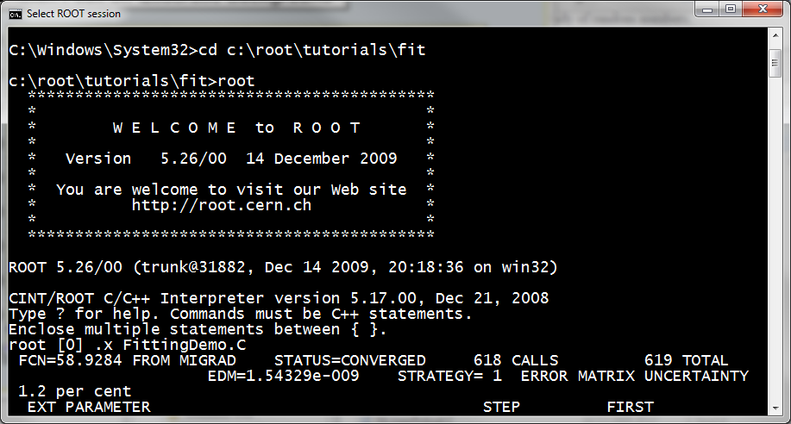
root

Slide 33
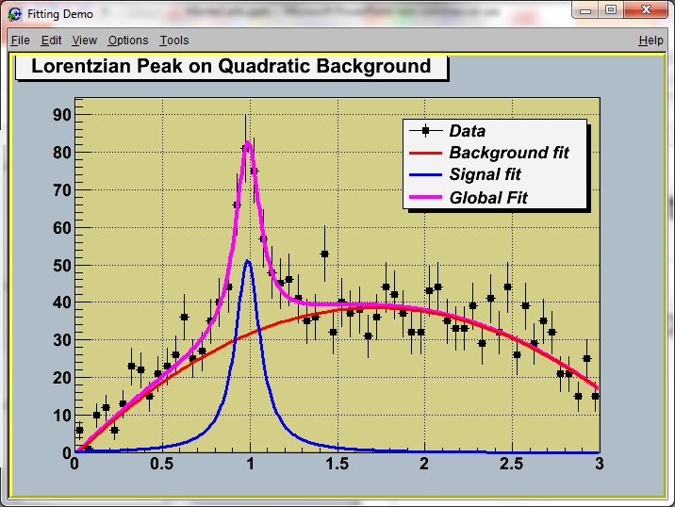

Slide 34
A Recommended Reference
The Particle Data Group (Review of Particles Properties)
http://pdg.lbl.gov/2010/reviews/contents_sports.html
Look at chapter 34 “MONTE CARLO TECHNIQUES”

Slide 35
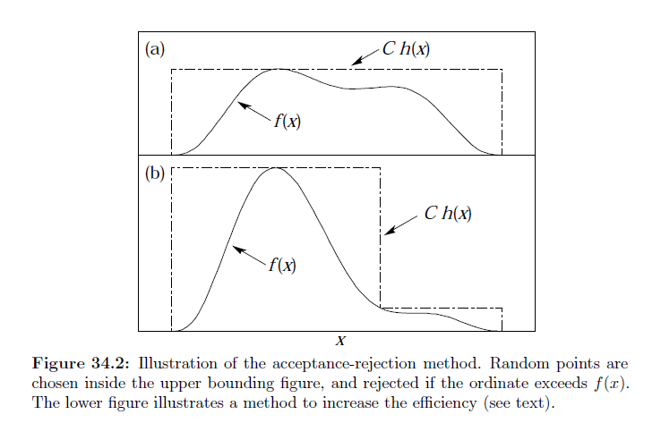
Acceptance-rejection method

Slide 36
R
R tutorial
Cloud Computing: Elastic-R demo

Slide 37
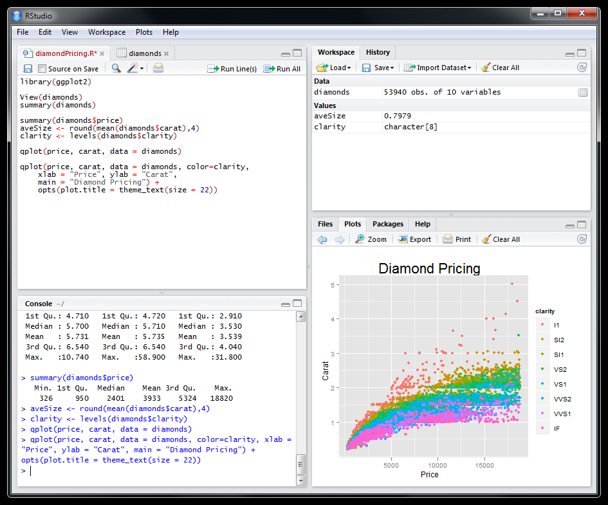
R studio http://www.rstudio.org

Slide 38
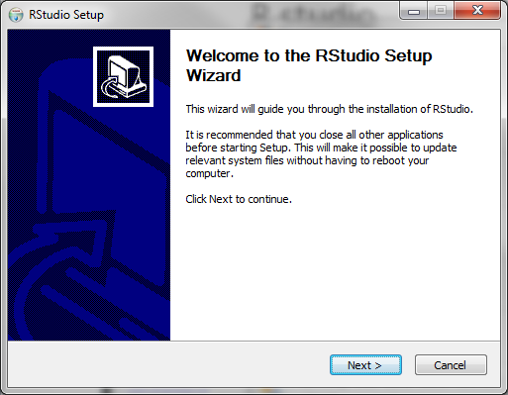
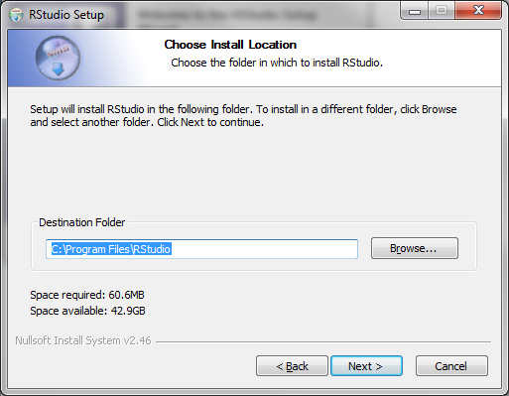
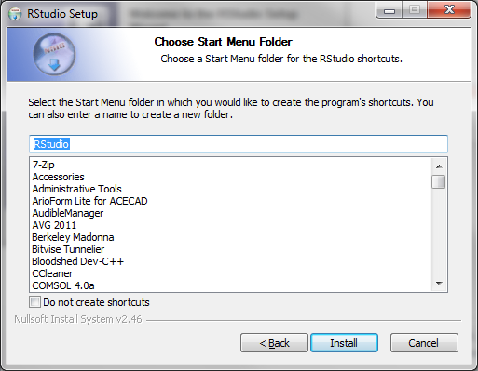

Slide 39
