Slide 1
Hellman’s Algorithm
Time / Memory tradeoff for finding a pre-image of a random function
June 2011
Weizmann Institute of Science

Slide 2
Problem definition
For any function f: {0,…,N-1}:{0,…,N-1}, given a value y from the image, find a pre-image x such that f(x)=y.
We can not assume anything about the internal structure of f.
In fact, we will consider f to be a random function.

Slide 3
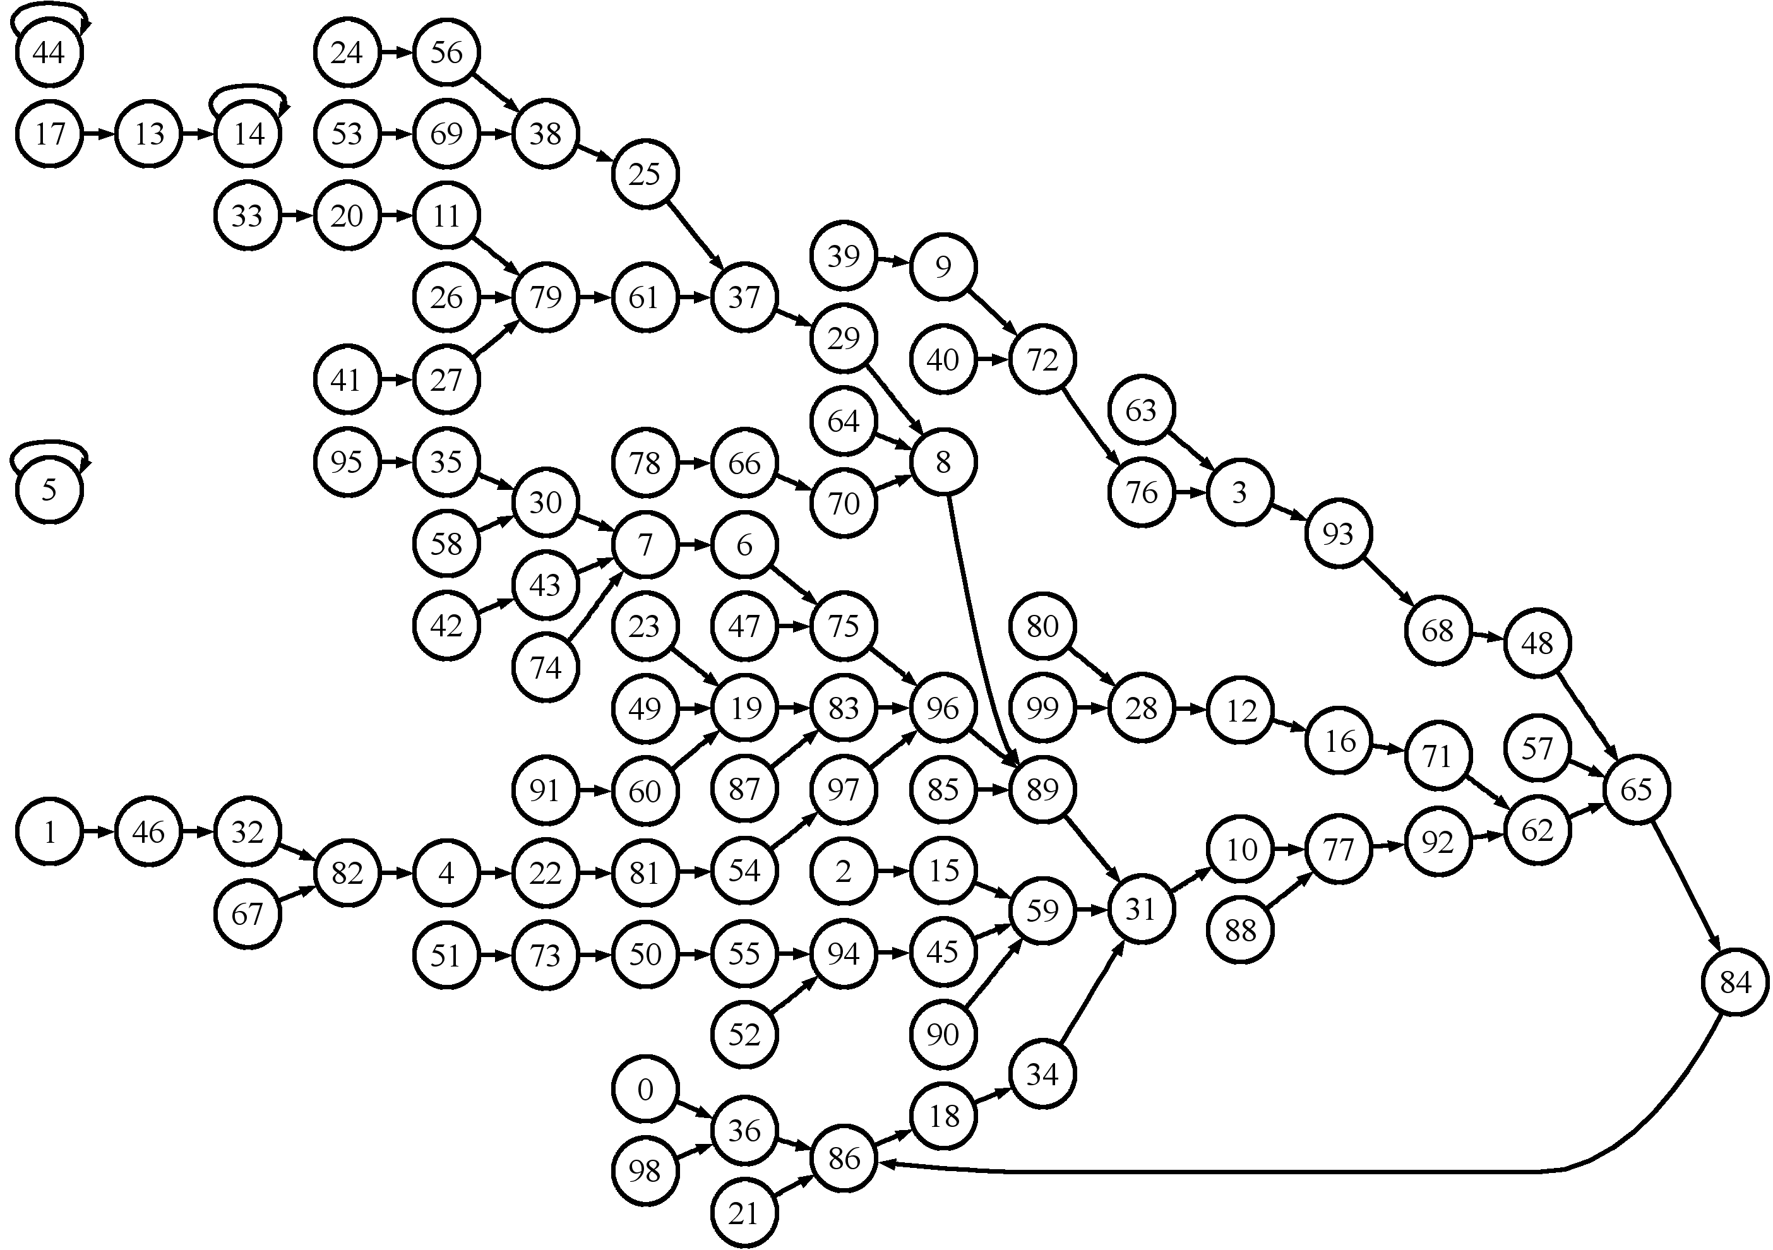
f as a random graph
Goal: Go backwards
Means: Going forwards

Slide 4
Solutions
Exhaustive search:
Query time complexity: $T≈N$
Memory complexity: $M≈$1
Exhaustive table:
Query time complexity: $T≈1$
Memory complexity: $M≈N$
Hellman’s algorithm would use a preprocessing phase to get:
Query time complexity: $T≈N^{2/3}$
Memory complexity: $M≈N^{2/3}$

Slide 5
Hellman’s Algorithm
Preprocessing phase:
Build l tables, each table has m chains, each chain starts from a random point and follows by invocations of f, until a chain-length of t is reached. We will save only start and end points.
Online phase:
Given y, compute a chain until reaching a value that is part of the endpoints or until we have a chain of length t.

Slide 6
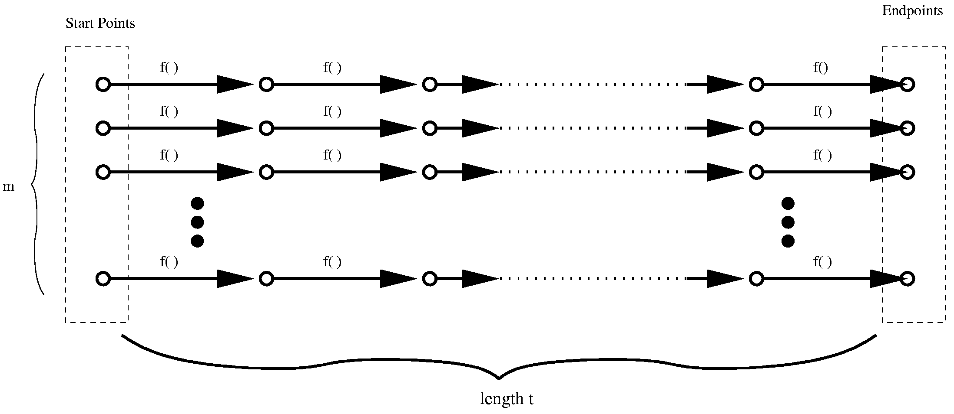
Online phase example
We start with y, building a chain up to an endpoint, then starting a new chain from the startpoint and reaching x.

Slide 7
Complexities
The most common set of parameters is $l=m=t=N^{1/3}$.
It will give us domain coverage of 80%.
Memory complexity: $M≈ml=N^{2/3}$
Query time complexity: $T≈tl=N^{2/3}$
Notice that all complexities are actually exponential because that the input size is n bits and $N=2^{n}$.

Slide 8
Practical improvements
I will make the preprocessing phase and the online phase parallel.
The benefit should be perfect (no dependencies).
So either Hellman’s algorithm or a simple exhaustive solution will be exponential, why use Hellman? There is a big difference between $2^{n}$ and $2^{\frac{2}{3}n}$. For $n=90$, an exhaustive search is not feasible but Hellman’s algorithm makes it feasible for big institutes.
Random function to be used: AES or any other cryptographic function.

Slide 9
Thank you

