Slide 1
Crack Propagation in Brittle Solids
CUDA Simulation
Benjy Kessler

Slide 2
Background
Given a brittle substance with a crack in it.
The goal is to study how the crack propagates in the substance as a function of time.
This accomplished by simulating the substance as a grid of points with forces acting upon them.
Based on a paper by Heizler, Kessler and Levine[1].

Slide 3
A little Physics
The simulation models a mode-III crack.
The bonds between molecules are modeled as springs with Hookean forces acting on them.
The spring breaks when the forces acting upon it exceed a certain threshold.
When the spring breaks the particles snap apart exerting more force on the neighboring particles, and the crack progresses.
There is no randomness built into the model but there is inherent randomness in floating point arithmetic.

Slide 4
The Simulation
A simulation was written to solve the propagation problem.
The simulation is a molecular dynamics simulation, where each particle obeys Newton’s Laws of Motion.
Each iteration the particles update their positions and velocities and cracked springs are eliminated.

Slide 5
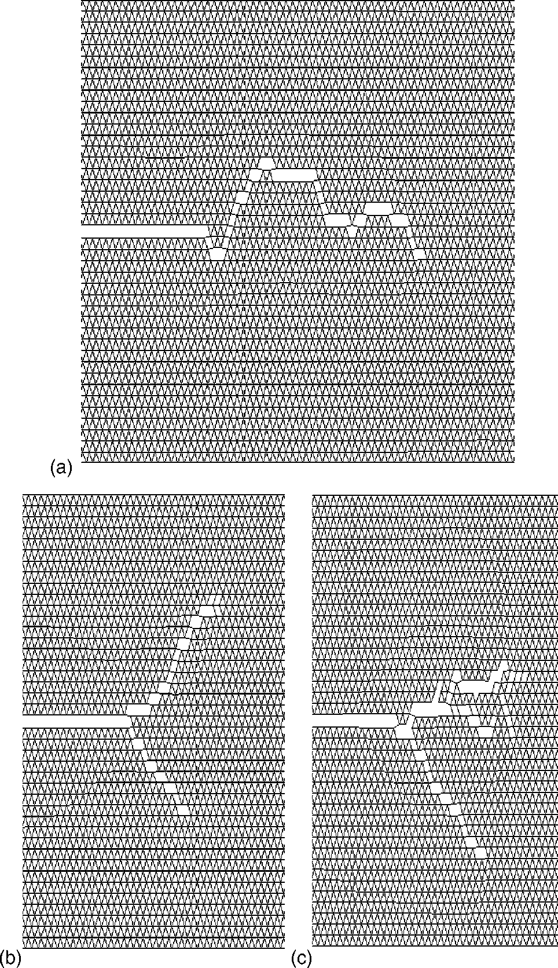
Graphs

Slide 6
The Project
The current implementation only utilizes the CPU, but not the GPU.
The goal of the project is to rewrite the project using CUDA.
This should speed up the running time of the simulation.
In addition it would be interesting to run the simulation on a cluster using Condor.

Slide 7
CUDA
CUDA is a C/C++ library which provides an interface to NVIDIA graphics cards.
Using CUDA you can easily run parallel programs on the graphics card.
You can download the CUDA SDK and documentation for free at http://developer.nvidia.com/cuda-downloads
Supports Windows (32,64) UNIX and Mac

Slide 8
CUDA Example[2]
float* h_A;
float* h_B;
float* h_C;
float* d_A;
float* d_B;
float* d_C;
// Device code
__global__ void VecAdd(const float* A, const float* B, float* C, int N)
{
int i = blockDim.x * blockIdx.x + threadIdx.x;
if (i < N)
C[i] = A[i] + B[i];
}
// Host code
int main(int argc, char** argv)
{
// Allocate input vectors h_A and h_B in host memory
h_A = (float*)malloc(size);
h_B = (float*)malloc(size);
h_C = (float*)malloc(size);

Slide 9
CUDA Example Cont.
// Initialize input vectors
RandomInit(h_A, N);
RandomInit(h_B, N);
// Allocate vectors in device memory
cutilSafeCall( cudaMalloc((void**)&d_A, size) );
cutilSafeCall( cudaMalloc((void**)&d_B, size) );
cutilSafeCall( cudaMalloc((void**)&d_C, size) );
// Copy vectors from host memory to device memory
cutilSafeCall( cudaMemcpy(d_A, h_A, size, cudaMemcpyHostToDevice) );
cutilSafeCall( cudaMemcpy(d_B, h_B, size, cudaMemcpyHostToDevice) );
// Invoke kernel
int threadsPerBlock = 256;
int blocksPerGrid = (N + threadsPerBlock - 1) / threadsPerBlock;
VecAdd<<<blocksPerGrid, threadsPerBlock>>>(d_A, d_B, d_C, N);
// Copy result from device memory to host memory
// h_C contains the result in host memory
cutilSafeCall( cudaMemcpy(h_C, d_C, size, cudaMemcpyDeviceToHost) );
}

Slide 10
Sources
[1] [2002] Heizler, S. ; Kessler, David ; Levine, H. "Mode-I Fracture in a Nonlinear Lattice with Viscoelastic Forces" Physical Review E, vol. 66, 2002, Art. No. 016126.
[2] Add Vector example in CUDA samples.

