Slide 1
Parallel Systems Course Summary
Guy Tel-Zur

Slide 3
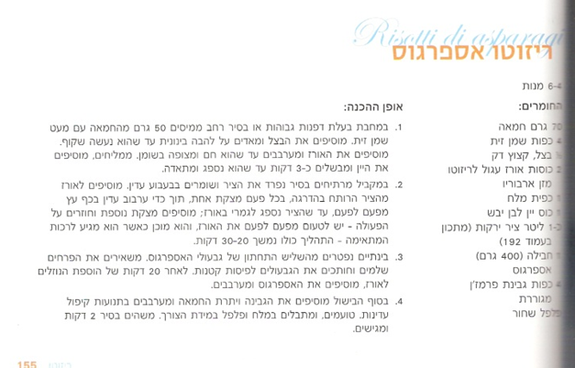
Multi threading in the kitchen

