Slide 1
Grid and Cloud Computing Lecture #6
Dr. Guy Tel-Zur

Slide 2
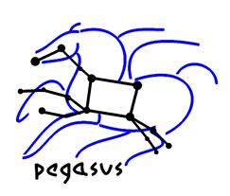
Agenda
Guest Lecture: Mr. Avner Algom IGT CEO
My introduction to Cloud Computing
Grid Appliance (presentation + demo)
Pegasus WMS (Workflow Management System)
Gridgain
UNICORE

Slide 3
Preparation to the exam
About the final projects (a separate presentation)

Slide 4
My Cloud Computing group in Facebook
http://www.facebook.com/groups/8450870046/
3,495 Members as of today |(10-May-2012)

