Slide 1
Scientific Computing Lecture 5
Dr. Guy Tel-Zur
Autumn Colors, by Bobby Mikul, http://www.publicdomainpictures.net
Version 17-04-2011 08:00

Slide 2
Agenda
Administration
MPI – Continue from last lecture
DeinoMPI short presentation
MPI Examples:
Parallel Integration
Parallel Mandelbrot set
Differential equations
MHJ Chapter 13 + S. Koonin Chapter 2
Matlab demos
Scilab demos
OpenMP mini-course
FlexPDE mini-course

Slide 3
Final Projects
In two weeks we must finalize the final projects topics.
Please devote time to search for a project
CPU intensive
Will use one or more of the computational tools and techniques we learnt in class

Slide 4
Feed Back
You are encouraged to send a feedback about all aspects of the course
Math level, CS level
Condor, MPI,…
Send an email to: tel-zur@computer.org

Slide 5
No Class Next Week. We Will Meet Again on 1/5

Slide 6
http://www.nature.com/news/2010/101013/full/467775a.html

Slide 7
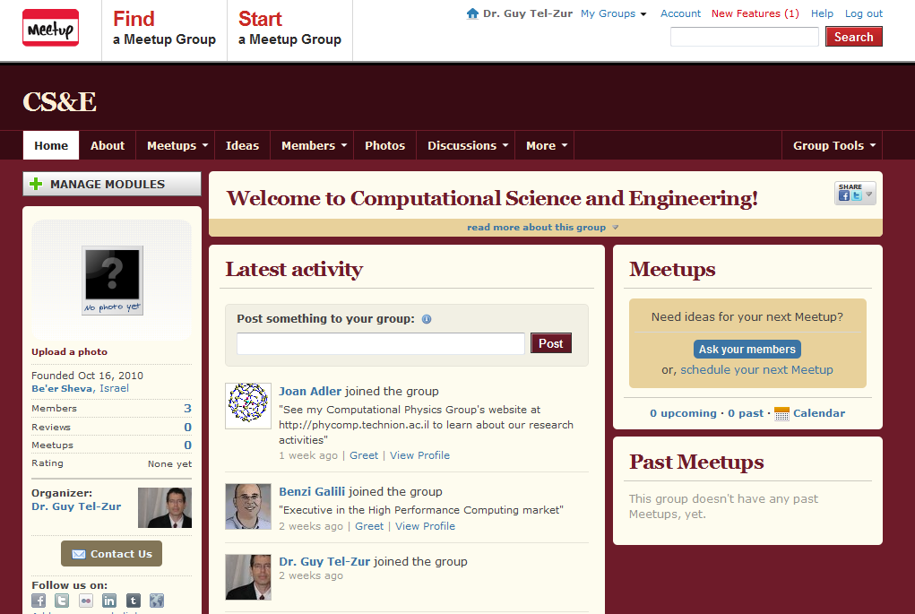
Join the Computational Science and Engineering group
http://www.meetup.com/ComputationalScience/

Slide 8
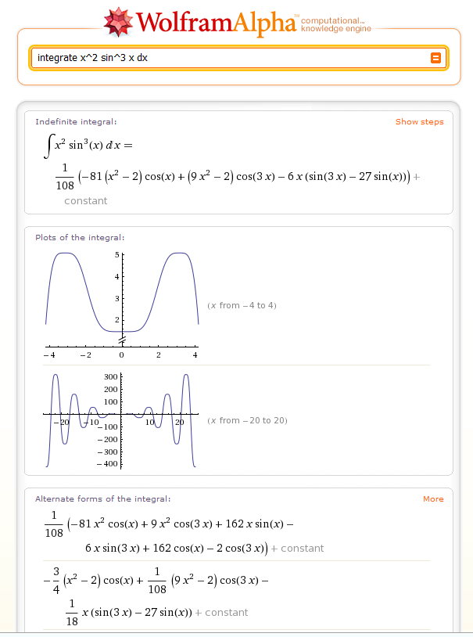
Wolfram Alpha -Computational Knowledge Engine
http://www.wolframalpha.com

Slide 9
MPI Tutorial
Continue tutorial from: https://computing.llnl.gov/tutorials/mpi/
Sections 1 to 6

Slide 10
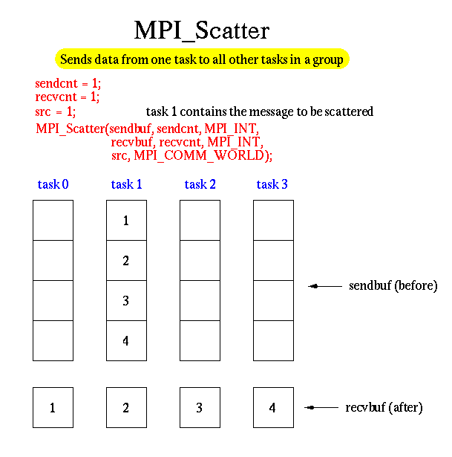
Collective Communications Example - Scatter

Slide 11
Collective Communications Example - Scatter
Show demo in Virtual box – Ubuntu OS. Folder: ~/mpi
#include "mpi.h"
#include <stdio.h>
#define SIZE 4
int main(argc,argv)
int argc;
char *argv[]; {
int numtasks, rank, sendcount, recvcount, source;
float sendbuf[SIZE][SIZE] = {
{1.0, 2.0, 3.0, 4.0},
{5.0, 6.0, 7.0, 8.0},
{9.0, 10.0, 11.0, 12.0},
{13.0, 14.0, 15.0, 16.0} };
float recvbuf[SIZE];
MPI_Init(&argc,&argv);
MPI_Comm_rank(MPI_COMM_WORLD, &rank);
MPI_Comm_size(MPI_COMM_WORLD, &numtasks);

Slide 12
Continued
if (numtasks == SIZE) {
source = 1;
sendcount = SIZE;
recvcount = SIZE;
MPI_Scatter(sendbuf,sendcount,MPI_FLOAT,recvbuf,recvcount,
MPI_FLOAT,source,MPI_COMM_WORLD);
printf("rank= %d Results: %f %f %f %f\n",rank,recvbuf[0],
recvbuf[1],recvbuf[2],recvbuf[3]);
}
else
printf("Must specify %d processors. Terminating.\n",SIZE);
MPI_Finalize();
}

Slide 13
MPI examples
Parallel Numerical Integration – Computing pi
Embarrassingly Parallel Computation – Mandelbrot set

Slide 14
Switch to DeinoMPI slides
Demo: execute the cpi.c code

Slide 15
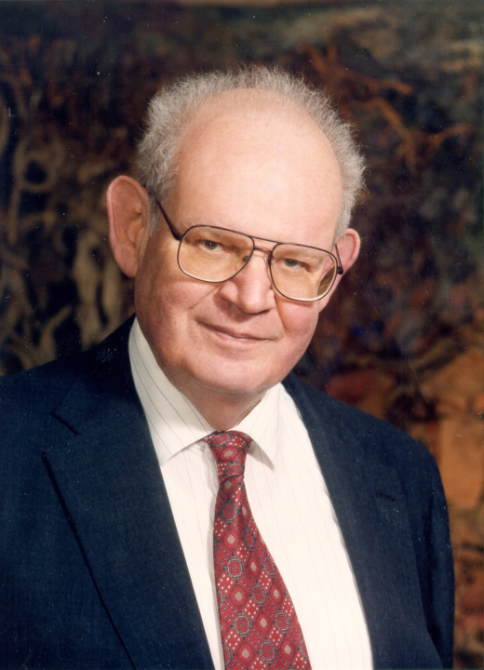
Benoît B. Mandelbrot (1924-2010), Father of Fractal Geometry
http://laughingsquid.com/benoit-b-mandelbrot-1924-2010-father-of-fractal-geometry/
http://vimeo.com/1908224
Died on Oct 15, 2010

Slide 16
Next slides are from online presentations by:
Dr. Barry Wilkinson
UNIVERSITY OF NORTH CAROLINA AT CHARLOTTE Department of Computer Science ITCS 4145/5145 Parallel Programming Spring 2009

Slide 17
Mandelbrot Set
Set of points in a complex plane that are quasi-stable (will increase and decrease, but not exceed some limit) when computed by iterating the function:
where z_{k +1} is the (k + 1)th iteration of complex number:
z = a + bi
and c is a complex number giving position of point in the complex plane. The initial value for z is zero.
3.10

Slide 18
Mandelbrot Set continued
Iterations continued until magnitude of z is:
Greater than 2
or
Number of iterations reaches arbitrary limit.
Magnitude of z is the length of the vector given by:
3.10

Slide 19
Sequential routine computing value of
one point returning number of iterations
structure complex {
float real;
float imag;
};
int cal_pixel(complex c)
{
int count, max;
complex z;
float temp, lengthsq;
max = 256;
z.real = 0; z.imag = 0;
count = 0; /* number of iterations */
do {
temp = z.real * z.real - z.imag * z.imag + c.real;
z.imag = 2 * z.real * z.imag + c.imag;
z.real = temp;
lengthsq = z.real * z.real + z.imag * z.imag;
count++;
} while ((lengthsq < 4.0) && (count < max));
return count;
}
3.11

Slide 20
Mandelbrot set
Show class live demo using Octave
3.12

Slide 21
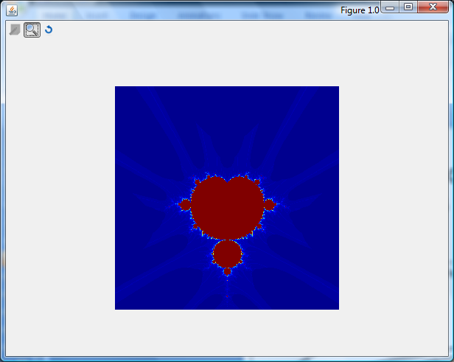
Demo: Guy’s Matlab program

Slide 22
Parallelizing Mandelbrot Set Computation
Static Task Assignment
Simply divide the region in to fixed number of parts, each computed by a separate processor.
Not very successful because different regions require different numbers of iterations and time.
3.13

Slide 23
Dynamic Task Assignment
Have processor request regions after computing previous
regions
3.14

Slide 24
Demo: parallel Mandelbrot set + parallel visualization
Open 2 DOS command line windows and cd to C:\Program Files (x86)\DeinoMPI\examples directory
Start pmandel using:
Window1: ..\bin\mpiexec –n 4 pmandel
Window2: pman_vis.exe (select the port from the “file” menu)

Slide 25
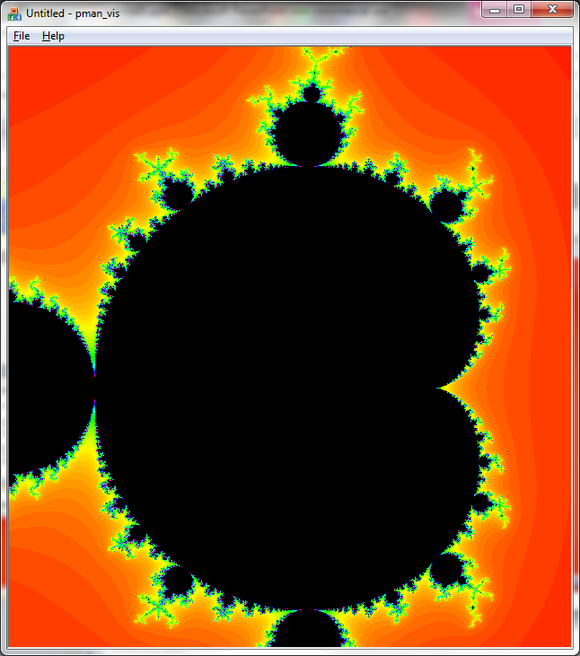
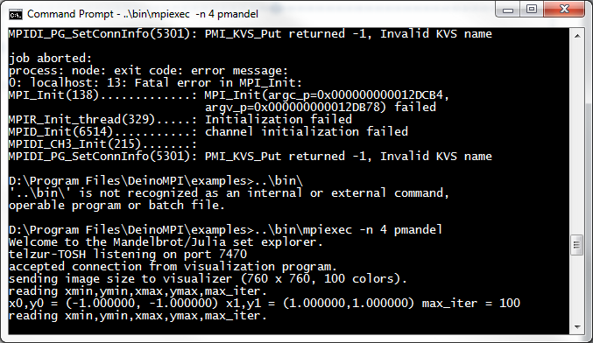
Mandelbrot set

Slide 26
FlexPDE mini course
Open the other pptx file

