Slide 1
Scientific Computing Lecture 4
Dr. Guy Tel-Zur

Slide 2
http://www.nature.com/news/2010/101013/full/467775a.html

Slide 3
Join the Computational Science and Engineering group
http://www.meetup.com/ComputationalScience/

Slide 4
The Final Projects – a reminder
We need to finalize the topics for the final projects by lecture #7
Next week (April 17) – There is a lecture
The week after that (April 24) – No lecture – Passover vacation, Right????

Slide 5
Agenda
Introduction to HPC – continued from slide 57
Linear Algebra (chapter 4 @ MHJ )
MPI Mini-course
Message Passing Interface (MPI) (LLNL tutorial)
DeinoMPI short presentation
Examples: cpi, mandelbrot)

Slide 6
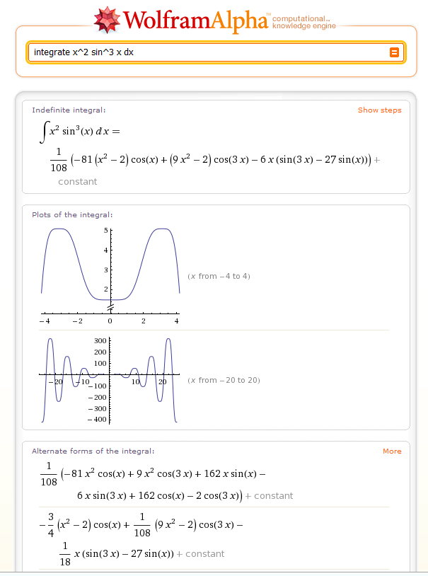
Wolfram Alpha -Computational Knowledge Engine
http://www.wolframalpha.com

Slide 7
MPI examples
Parallel Numerical Integration – Computing pi
Embarrassingly Parallel Computation – Mandelbrot set

Slide 8
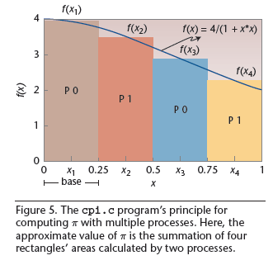
Figures in this slide are taken from: “Ch MPI: Interpretive Parallel Computing in C”, By Yu-Cheng Chou
Chung Yuan Christian University, Taiwan. Stephen S. Nestinger, Worcester Polytechnic Institute.
Harry H. Cheng, University of California, Davis
Computing in Science and Engineering, March/April 2010

Slide 9
cpi.c
/************************************************
* File: cpi.c
* Purpose: Parallel computation of pi with the
* number of intervals from standard input.
************************************************/
#include <mpi.h>
#include <stdio.h>
#include <math.h>
int main(int argc, char *argv[]) {
int n, myid, numprocs, i;
double PI25DT = 3.141592653589793238462643;
double mypi, pi, h, sum, x;
MPI_Init(&argc, &argv);
MPI_Comm_size(MPI_COMM_WORLD, &numprocs);
MPI_Comm_rank(MPI_COMM_WORLD, &myid);
while(1) {
if(myid == 0) {
printf("Enter the number of intervals:
(0 quits) ");
scanf("%d", &n);
}

Slide 10
Continued from previous slide
MPI_Bcast(&n, 1, MPI_INT, 0, MPI_COMM_WORLD);
if(n == 0) { // program quits if the interval is 0
break;
}
else {
h = 1.0 / (double)n;
sum = 0.0;
for(i=myid+1; i<=n; i+=numprocs) {
x = h * ((double)i - 0.5);
sum += (4.0 / (1.0 + x*x));
}
mypi = h * sum;
MPI_Reduce(&mypi, &pi, 1, MPI_DOUBLE, MPI_SUM,
0, MPI_COMM_WORLD);
if(myid == 0) {
printf("PI is %.16f, Error is %.16f\n“,pi, fabs(pi - PI25DT));
}
} // n!=0
} // end of while
MPI_Finalize();
return 0;
} // end of main

Slide 11
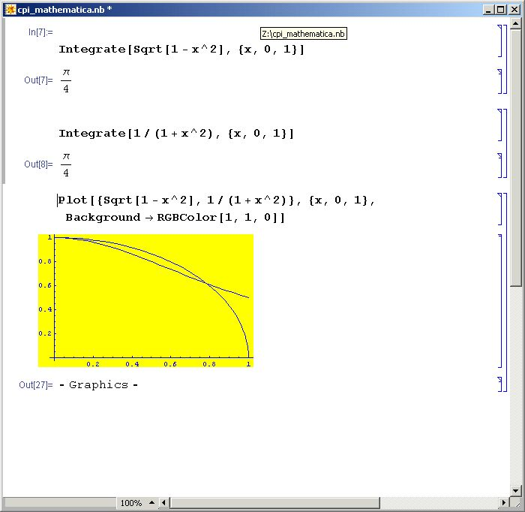

Slide 12
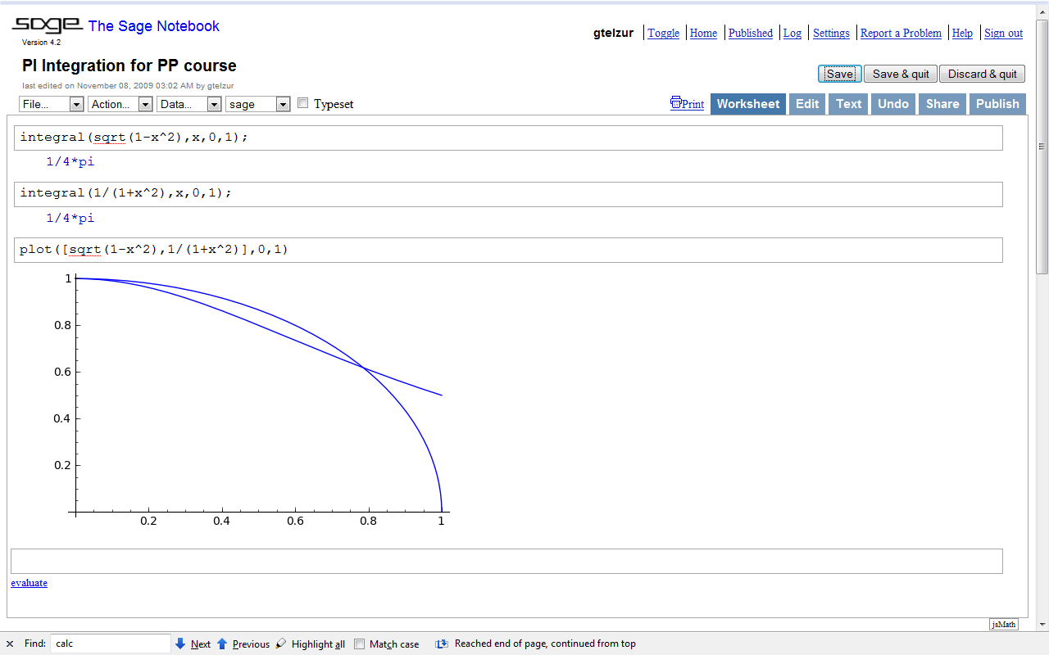
http://www.sagenb.org

Slide 13
Switch to DeinoMPI slides
Demo: execute the cpi.c code

Slide 14
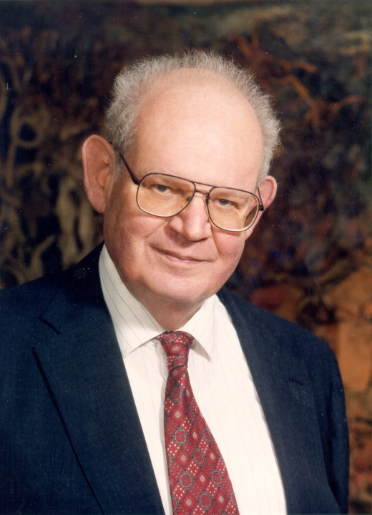
Benoît B. Mandelbrot (1924-2010), Father of Fractal Geometry
http://laughingsquid.com/benoit-b-mandelbrot-1924-2010-father-of-fractal-geometry/
http://vimeo.com/1908224
Died on Oct 15, 2010

Slide 15
Next slides are from online presentations by:
Dr. Barry Wilkinson
UNIVERSITY OF NORTH CAROLINA AT CHARLOTTE Department of Computer Science ITCS 4145/5145 Parallel Programming Spring 2009

Slide 16
Mandelbrot Set
Set of points in a complex plane that are quasi-stable (will increase and decrease, but not exceed some limit) when computed by iterating the function:
where z_{k +1} is the (k + 1)th iteration of complex number:
z = a + bi
and c is a complex number giving position of point in the complex plane. The initial value for z is zero.
3.10

Slide 17
Mandelbrot Set continued
Iterations continued until magnitude of z is:
Greater than 2
or
Number of iterations reaches arbitrary limit.
Magnitude of z is the length of the vector given by:
3.10

Slide 18
Sequential routine computing value of
one point returning number of iterations
structure complex {
float real;
float imag;
};
int cal_pixel(complex c)
{
int count, max;
complex z;
float temp, lengthsq;
max = 256;
z.real = 0; z.imag = 0;
count = 0; /* number of iterations */
do {
temp = z.real * z.real - z.imag * z.imag + c.real;
z.imag = 2 * z.real * z.imag + c.imag;
z.real = temp;
lengthsq = z.real * z.real + z.imag * z.imag;
count++;
} while ((lengthsq < 4.0) && (count < max));
return count;
}
3.11

Slide 19
Mandelbrot set
Show class live demo using Octave
3.12

Slide 20
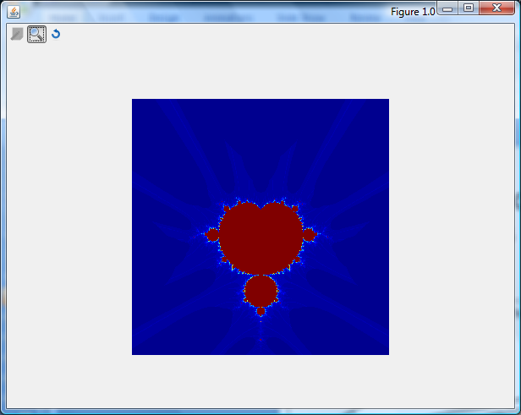
Demo: Guy’s Matlab program

Slide 21
Parallelizing Mandelbrot Set Computation
Static Task Assignment
Simply divide the region in to fixed number of parts, each computed by a separate processor.
Not very successful because different regions require different numbers of iterations and time.
3.13

Slide 22
Dynamic Task Assignment
Have processor request regions after computing previous
regions
3.14

Slide 23
Demo: parallel Mandelbrot set + parallel visualization
Open 2 DOS command line windows and cd to C:\Program Files (x86)\DeinoMPI\examples directory
Start pmandel using:
Window1: ..\bin\mpiexec –n 4 pmandel
Window2: pman_vis.exe (select the port from the “file” menu)

