Slide 1
Parallel Systems
Dr. Guy Tel-Zur

Slide 2
Today’s Agenda
Numerical Algorithms (Wilkinson and Allen Chapter 11)
Cilk++
UPC
HTCondor

Slide 3
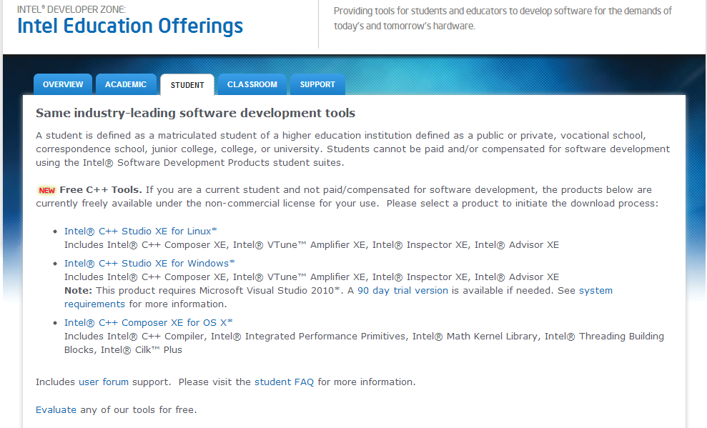
Intel Free Tools for Students
http://software.intel.com/en-us/intel-education-offerings#pid-2460-93

Slide 4
Administration
Home Assignments
Presentations
Next week: Lab @room 217

