Slide 1
Parallel Processing
Dr. Guy Tel-Zur

Slide 2
Agenda
מטרת החלק הראשון של השיעור: לעשות חזרה על חלק מהמושגים שנלמדו בשיעורים הקודמים ולעבות ולסכם את הידע בנושאים אלה
Sending a 2D array in MPI
Network Performance – Revisited
Collective commands
Send/Recv types and summary
בחלק השני של השיעור נלמד נושאים חדשים:
Performance Evaluation of Parallel Programs
PBS demo
Parallel Computing environments for this course
Synchronous Parallel Computations

Slide 3
מנהלה
הרצאות הגמר – לחפש נושא (ראו אתר הקורס)
עד שיעור מס' 8, על כל צוות לקבל אישור מהמרצה אודות נושא הרצאת הגמר שלו

Slide 4
Recommended online references
Designing and Building Parallel Programs,
by Ian Foster http://www.mcs.anl.gov/~itf/dbpp/
http://www.mhpcc.edu/training/workshop/parallel_intro/MAIN.html
https://computing.llnl.gov/tutorials/parallel_comp/ by Blaise Barney, Livermore Computing

Slide 5
Another Linux Reference
People who still don’t feel comfortable with linux please consult this reference:
http://sc.tamu.edu/shortcourses/SC-unix/introToUnix.pdf

Slide 6
About the status in MPI_Recv
It is possible to Receive messages in non-selective ways:
source = MPI_ANY_SOURCE
tag = MPI_ANY_TAG
This is useful for example in a Master-Worker style where the master holds a workpool and it gives a work unit upon each “recv”.

Slide 7
M-W Demo
Embarrassingly Parallel Computation
π calculation by Monte Carlo (Previous lecture)
Demo under:
/users/agnon/misc/tel-zur/mpi/pi_monte_carlo
- Execution:
mpirun -np 4 ./pi_reduce
The source code – open IDE

Slide 8
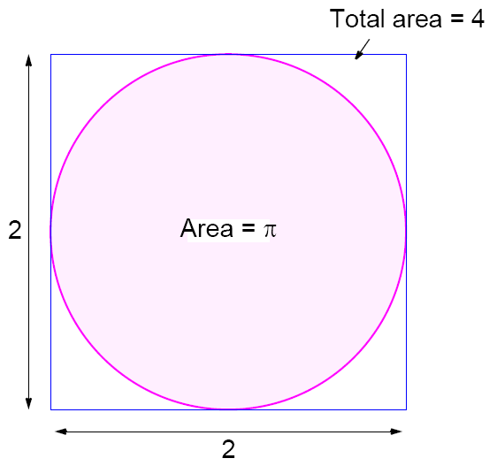
Master-Worker (M-W) Demo
Embarrassingly Parallel Computing paradigm
Calculation of π

Slide 9
Pseudo Code - Serial Version
npoints = 10000
circle_count = 0
do j = 1,npoints
generate 2 random numbers between 0 and 1
xcoordinate = random1
ycoordinate = random2
if (xcoordinate, ycoordinate) inside circle then
circle_count = circle_count + 1
end do
PI = 4.0*circle_count/npoints

Slide 10
Pseudo Code - Parallel Version
npoints = 10000
circle_count = 0
p = number of tasks
num = npoints/p
find out if I am MASTER or WORKER
do j = 1,num
generate 2 random numbers between 0 and 1
xcoordinate = random1
ycoordinate = random2
if (xcoordinate, ycoordinate) inside circle then
circle_count = circle_count + 1
end do
if I am MASTER
receive from WORKERS their circle_counts compute PI (use MASTER and WORKER calculations)
else if I am WORKER
send to MASTER circle_count
endif
Must use different seeds

Slide 11
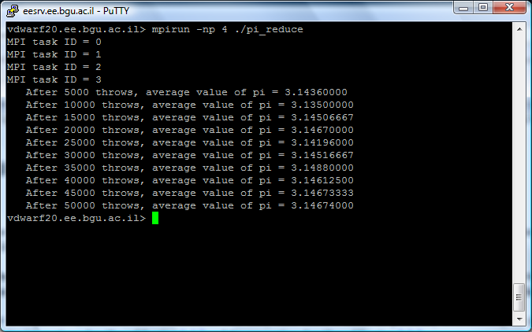
M – W Monte-Carlo calculation of π

Slide 12
Reference to the source code:
http://www.pdc.kth.se/training/Tutor/MPI/Templates/pi/index.html#top
pi_send.c
pi_reduce.c
dboard.c
make.pi.c
However, I had to modify the scaling of random numbers – see next slide

Slide 13
0<r<1
Instead of:
cconst = 2 << (31 - 1);
r = (double)random()/cconst;
I had to change the code to:
r = ((double)rand() / ((double)(RAND_MAX)+(double)(1)));

Slide 14
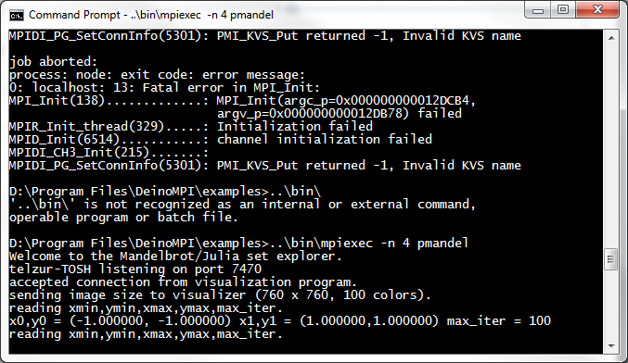
Mandelbrot set

Slide 15
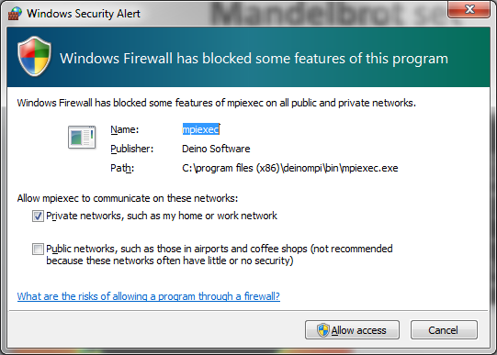
MPI on Windows…
Usage: client – servers mode
cd to c:\program files (x86)\deinompi\examples
on shell window #1: ..\bin\mpiexec –n 4 pmandel
on shell window #2: pmandel_vis, then open TCP port 7470

Slide 16
Sending a 2D array in MPI between two tasks
A simple demo – turn to the demo
The source code is enclosed – next slide
Implementation on Windows Vista using DeinoMPI and DevC++

Slide 17
// Guy Tel-Zur (c) 2009 // This is a demo for PP2010A course // sending a 2D array - study pointers #include <mpi.h> int main (int argc, char **argv) { int dim = 3; // array dimension int smat[dim][dim]; //send matrix[row][col] int rmat[dim][dim]; // recv matrix int i,j; int mytid, nproc; int MASTER = 0; int WORKER = 1; int tag = 99; MPI_Status status; MPI_Init(&argc, &argv); MPI_Comm_rank(MPI_COMM_WORLD, &mytid); MPI_Comm_size(MPI_COMM_WORLD, &nproc); printf ("MPI task ID = %d\n", mytid); if (nproc != 2) { printf("This program needs exactly 2 processes\n"); exit (1); } | if (mytid == 0) { // fill the matrix smat[0][0] = 1; smat[1][0] = 4; smat[2][0] = 7; smat[0][1] = 2; smat[1][1] = 5; smat[2][1] = 8; smat[0][2] = 3; smat[1][2] = 6; smat[2][2] = 9; printf("Thie is master\n"); for (i=0;i<dim;i++) { for (j=0;j<dim;j++) printf("%i",smat[i][j]); printf("\n"); } // send the 2D matrix as a linear array to the Worker MPI_Send(&smat,dim*dim,MPI_INT,WORKER,tag,MPI_COMM_WORLD); } else { MPI_Recv(rmat,dim*dim,MPI_INT,MASTER,tag,MPI_COMM_WORLD,&status); printf("The is worker\n"); for (i=0;i<dim;i++) { for (j=0;j<dim;j++) printf("%i",rmat[i][j]); printf("\n"); } } // That's it! MPI_Finalize(); }

Slide 18
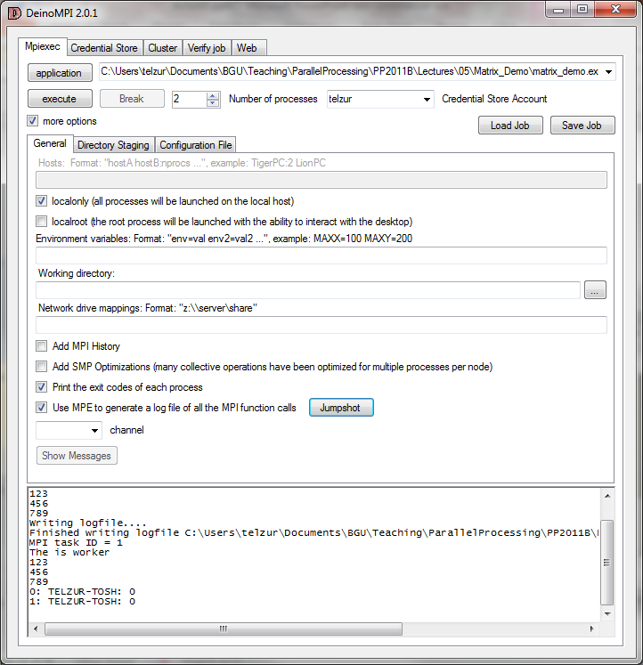
Use DeinoMPI for the demo!!!

Slide 19
Network Performance
The time needed to transmit data
Source: Stanford

Slide 20
MPI_Isend
“Latency Hiding”
Identifies an area in memory to serve as a send buffer. Processing continues immediately without waiting for the message to be copied out from the application buffer. A communication request handle is returned for handling the pending message status. The program should not modify the application buffer until subsequent calls to MPI_Wait or MPI_Test indicate that the non-blocking send has completed.

Slide 21
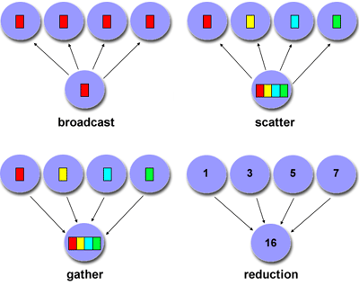
Some Common Collective Commands
Source: https://computing.llnl.gov/tutorials/parallel_comp/

Slide 22
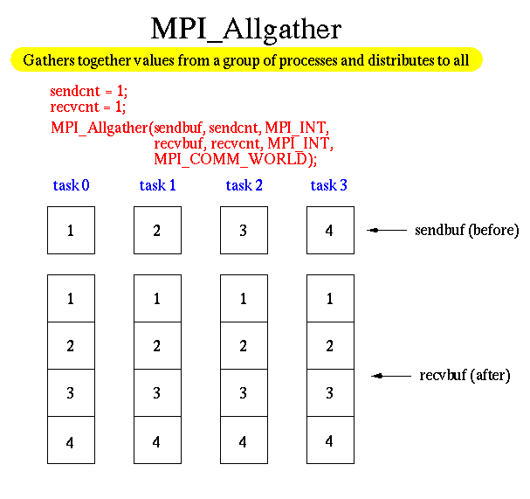
Allgather

Slide 23
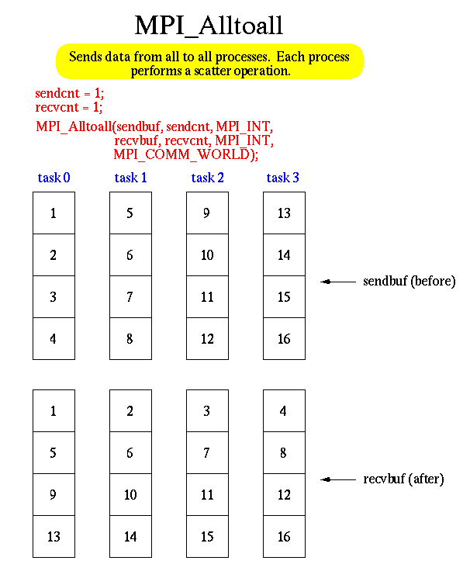

Slide 24
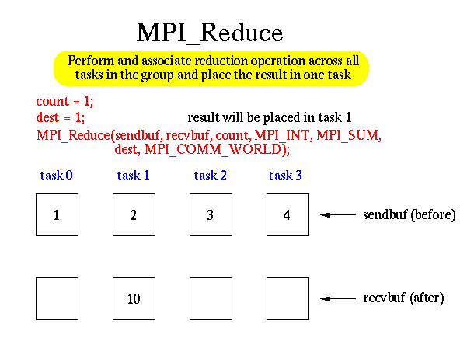
MPI_Reduce

Slide 25
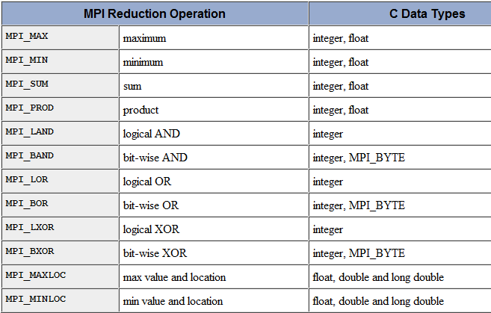
MPI_Reduce

Slide 26
MPI_Reduce
Users can also define their own reduction functions by using the MPI_Op_create routine

Slide 27
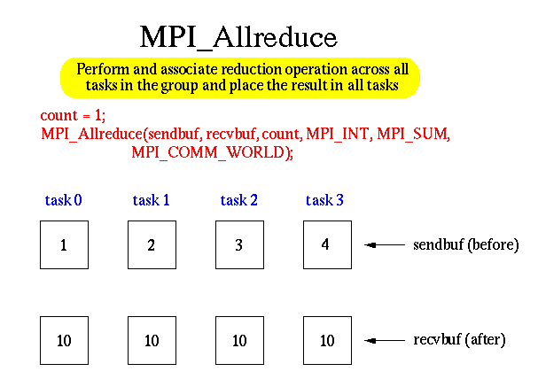
MPI_Allreduce

Slide 28
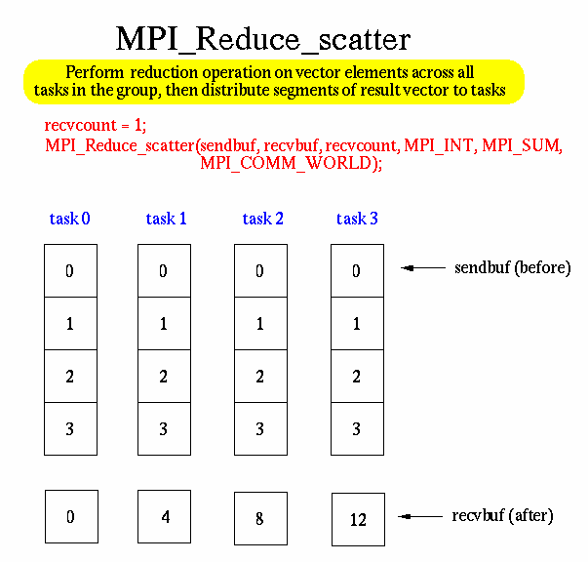
MPI_Reduce_scatter

Slide 29
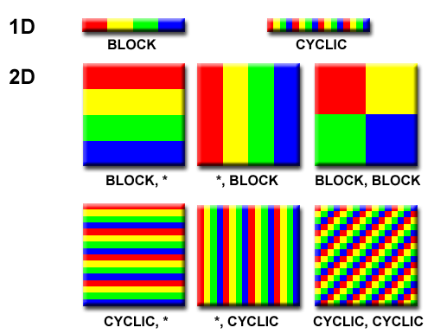
Domain Decomposition: Different ways to partition data
Source: https://computing.llnl.gov/tutorials/parallel_comp/

Slide 30
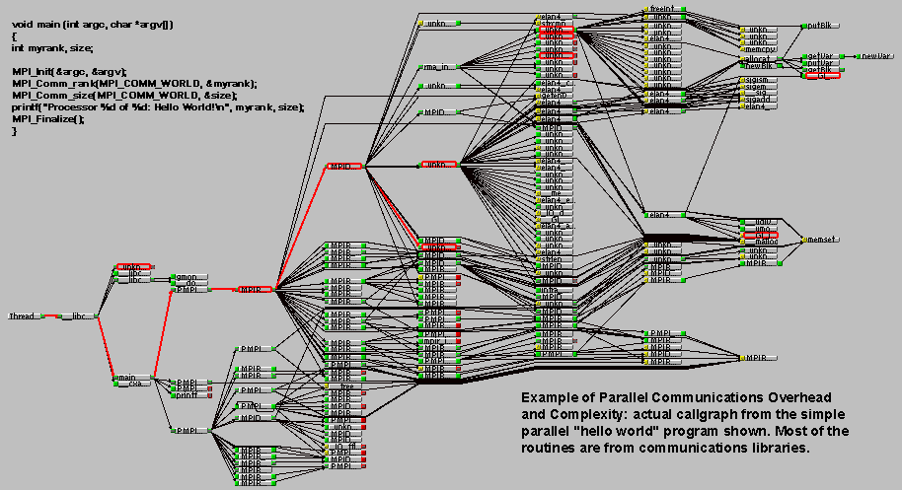
Overhead and Complexity
Source: https://computing.llnl.gov/tutorials/parallel_comp/

Slide 31
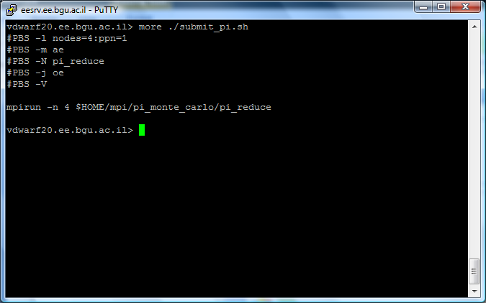
PBS/Torque – job scheduling

Slide 32
-N myjob15 specifies the name of the job will be myjob15
-l nodes=1:ppn=1 specified that the job will use 1 node and that there is 1 processor per node.

Slide 33
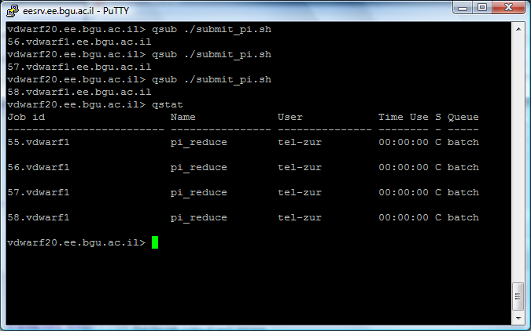
PSB/Torque

Slide 34
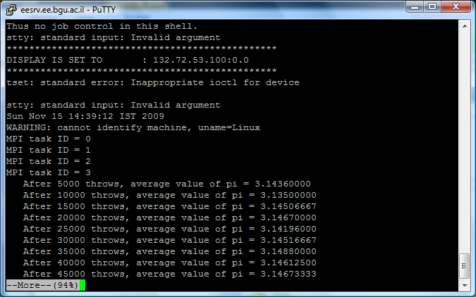
PSB/Torque

Slide 35
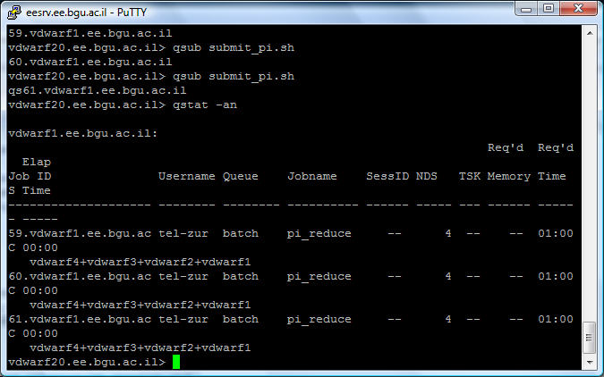

Slide 36
References
Torque:
http://www.clusterresources.com/products/torque-resource-manager.php
OpenPBS:
http://openpbs.org

Slide 37
Parallel Computing environments for this course
Our Linux Cluster: vdwarf
Your own resources:
A dedicated Linux installation with MPI
Install MPI on Windows
Dual boot Linux/Windows
Windows + Cygwin
Virtualization:
VMware Player, VirtualBox…
Parallel Computing on the Cloud ($)

Slide 38
Turn to Algorithms Slides
Synchronous Parallel Computations

