Slide 1
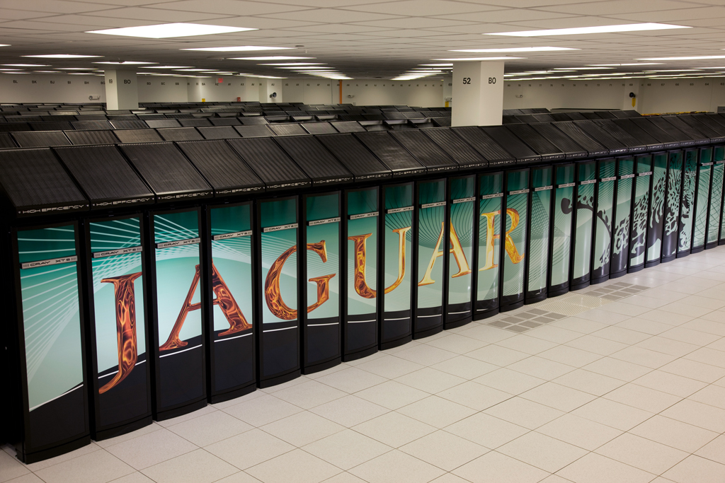
Parallel Systems
Guy Tel-Zur
tel-zur@computer.org

Slide 2
Talk Outline
Motivation
Basic terms
S/W. Methods of Parallelization
Examples
Profiling, Benchmarking and Performance Tuning
H/W
Supercomputers
HTC and Condor
Grid Computing and Cloud Computing
Future Trends

Slide 3
A Definition from
Oxford Dictionary of Science:
A technique that allows more than one process – stream of activity – to be running at any given moment in a computer system, hence processes can be executed in parallel. This means that two or more processors are active among a group of processes at any instant.

Slide 4
Motivation
Basic terms
Parallelization methods
Examples
Profiling, Benchmarking and Performance Tuning
Common H/W
Supercomputers
HTC and Condor
The Grid
Future trends

Slide 5
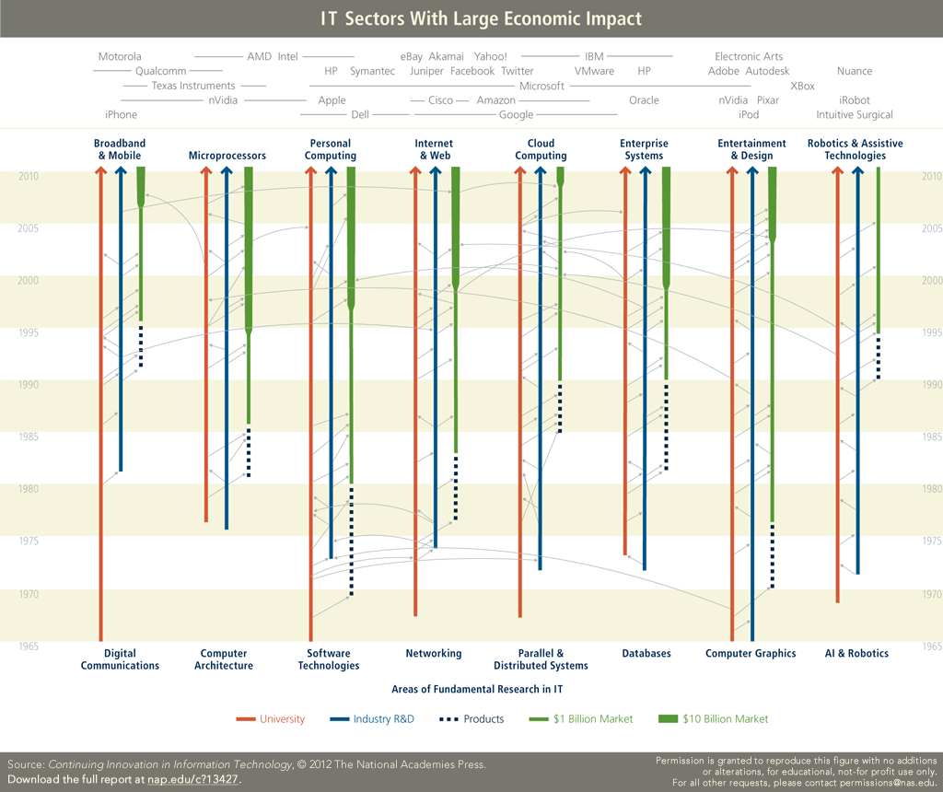
Source: https://download.nap.edu/catalog.php?record_id=13427

Slide 6
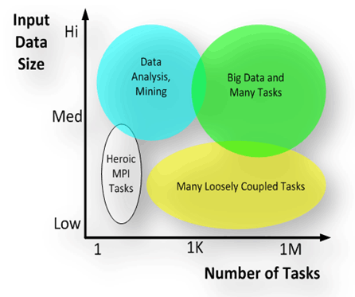
iSGTW Opinion - Many Task Computing: Bridging the performance-throughput gap. JANUARY 28, 2009
Image courtesy of Ioan Raicu, University of Chicago.
Notes:
In the lower left corner, the low number of tasks and small input size makes tightly-coupled Message Passing Interface (MPI) quite manageable. This is the traditional terrain of HPC.
As the data size increases (vertically), we move into the analytics category, such as data mining and analysis.
In the lower right corner, data size remains modest, but the increasing number of tasks moves us into loosely-coupled applications involving many tasks. HTC can be considered a subset of this category.
Finally, the combination of both many tasks and large datasets in the upper right corner moves us into the province of Many-Task Computing. MTC can also be considered as part of the high-task, low data (lower right) area.
Image courtesy of Ioan Raicu, University of Chicago.

Slide 7
The need for Parallel Processing
Get the solution faster and or solve a bigger problem
Other considerations…(for and against)‏
  Power -> MutliCores
Serial processor limits
DEMO:
N=input('Enter dimension: ')
A=rand(N);
B=rand(N);
tic
C=A*B;
toc

Slide 8
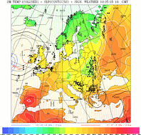
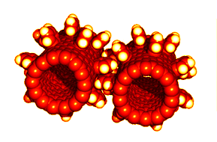
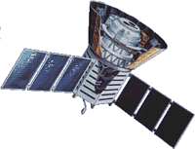
Why Parallel Processing
The universe is inherently parallel, so parallel models fit it best.
חיזוי מז"א
חישה מרחוק
"ביולוגיה חישובית"

Slide 9
The Demand for Computational Speed
Continual demand for greater computational speed from a computer system than is currently possible. Areas requiring great computational speed include numerical modeling and simulation of scientific and engineering problems. Computations must be completed within a “reasonable” time period.

Slide 10
Exercise
In a galaxy there are 10^11 stars
Estimate the computing time for 100 iterations assuming O(N^2) interactions on a 1GFLOPS computer

Slide 11
Solution
For 10^11 starts there are 10^22 interactions
X100 iterations → 10^24 operations
Therefore the computing time:
Conclusion: Improve the algorithm! Do approximations…hopefully n log(n)‏

Slide 12

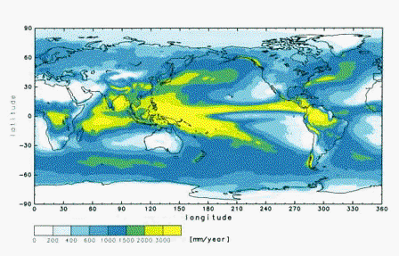

Large Memory Requirements
Use parallel computing for executing larger problems which require more memory than exists on a single computer.
2004 Japan’s Earth Simulator (35TFLOPS)‏
2011 Japan’s K Computer (8.2PF)
An Aurora simulation

Slide 13
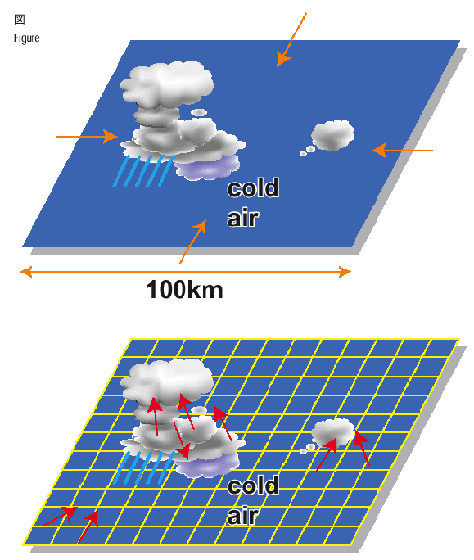

Slide 14
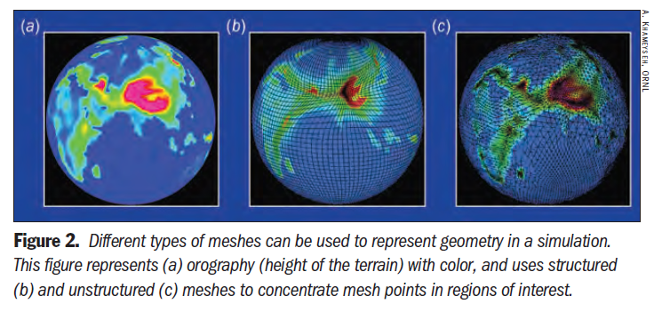
Source: SciDAC Review, Number 16, 2010

Slide 15
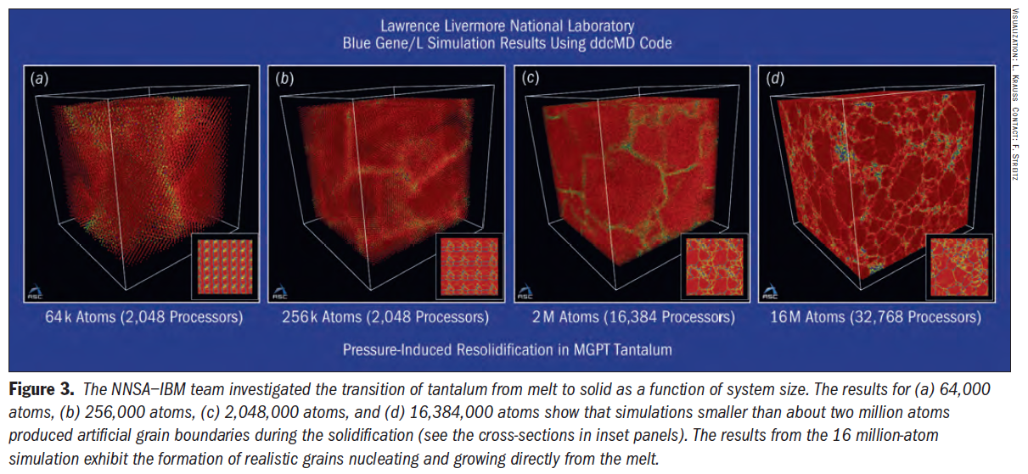
Molecular Dynamics
Source: SciDAC Review, Number 16, 2010

Slide 16
Other considerations
Development cost
  Difficult to program and debug
  TCO, ROI…

Slide 17
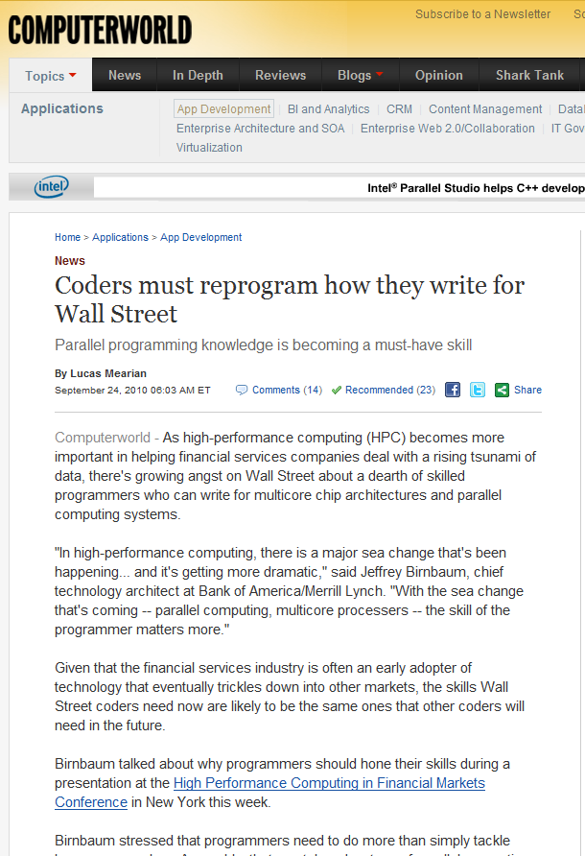
ידיעה לחיזוק המוטיבציה למי שעוד לא השתכנע בחשיבות התחום...
24/9/2010

Slide 18
Motivation
Basic terms
Parallelization methods
Examples
Profiling, Benchmarking and Performance Tuning
Common H/W
Supercomputers
HTC and Condor
The Grid
Future trends

Slide 19
Basic terms
Buzzwords
Flynn’s taxonomy
Speedup and Efficiency
Amdah’l Law
Load Imbalance

Slide 20
Buzzwords
Farming → Embarrassingly parallel
Parallel Computing - simultaneous use of
multiple processors
Symmetric Multiprocessing (SMP) - a single address space.
Cluster Computing - a combination of commodity
units.
Supercomputing - Use of the fastest, biggest machines to solve large problems.

Slide 21
Flynn’s taxonomy
single-instruction single-data streams (SISD)‏
single-instruction multiple-data streams (SIMD)‏
multiple-instruction single-data streams (MISD)‏
multiple-instruction multiple-data streams (MIMD) → SPMD

Slide 22
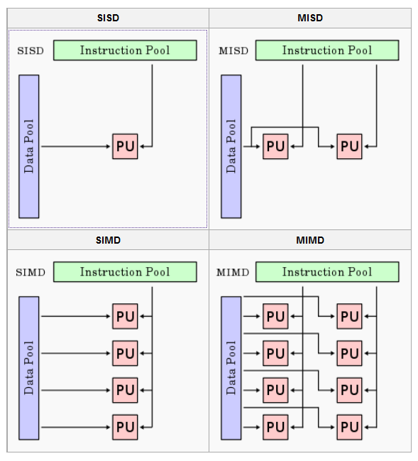
http://en.wikipedia.org/wiki/Flynn%27s_taxonomy

Slide 23
“Time” Terms
Serial time, t_{s} = Time of best serial (1 processor) algorithm.
Parallel time, t_{P} = Time of the parallel algorithm + architecture to solve the problem using p processors.
Note: t_{P} ≤ t_{s} but t_{P=1} ≥ t_{s} many times we assume t₁ ≈ t_{s}

Slide 24
מושגים בסיסיים חשובים ביותר!
Speedup: t_{s} / t_{P} ;0 ≤ s.u. ≤p
Work (cost): p * t_{P} ; t_{s} ≤W(p) ≤∞
(number of numerical operations)
Efficiency: t_{s} / (p * t_{P}) ; 0 ≤ε ≤1
(w₁/w_{p})

Slide 25
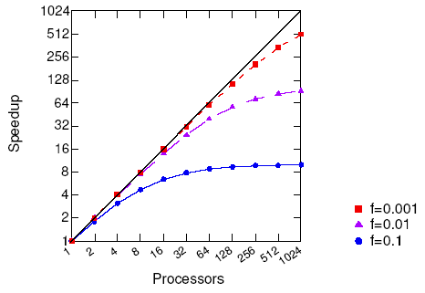
Maximal Possible Speedup
Notes:
F is the serial part of the code

Slide 26
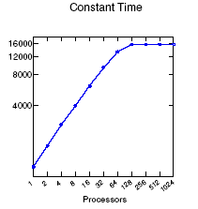
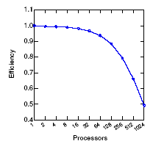
Scaling
Fixed data size/proc
Problem size increases
Find largest problem solvable

Slide 27
Amdahl’s Law (1967)‏

Slide 28
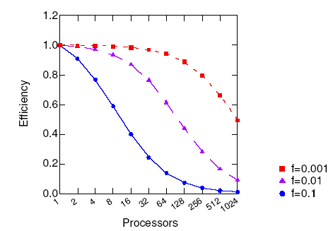
Maximal Possible Efficiency
ε = t_{s} / (p * t_{P}) ; 0 ≤ε ≤1
Notes:
Eff=1/(f(p-1)+1)‏

Slide 29
Amdahl’s Law - continue
With only 5% of the computation being serial, the maximum speedup is 20

Slide 30
An Example of Amdahl’s Law
Amdahl’s Law bounds the speedup due to any improvement.
– Example: What will the speedup be if 20% of the exec. time is in interprocessor communications which we can improve by 10X?
S=T/T’= 1/ [.2/10 + .8] = 1.25
=> Invest resources where time is spent. The slowest portion will
dominate.
Amdahl’s Law and Murphy’s Law:
“If any system component can
damage performance, it will.”
Notes:
Ref: m5 notes from SC04.
diminishing returns principle that (after a certain point) increasing only one factor of production while others remain the same will eventually result in lower output
חוק התמורה השולית הפוחתת

Slide 31
Gustafson’s Law
f is the fraction of the code that can not be parallelized
t_{p}=f*t_{p} + (1-f)*t_{p}
t_{s}=f*t_{p} + (1-f)*p*t_{p}
S=t_{s}/t_{p}=f+(1-f)*p this is the Scaled Speedup
S=f+p-fp=p+(1-p)f=f+p(1-f)
The Scaled Speedup is linear with p !

Slide 32
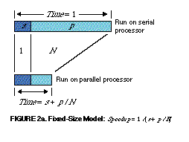
http://www.scl.ameslab.gov/Publications/Gus/AmdahlsLaw/Amdahls.html
Amdahl, G.M. Validity of the single-processor approach to achieving large scale computing capabilities. In AFIPS Conference Proceedings vol. 30 (Atlantic City, N.J., Apr. 18-20). AFIPS Press, Reston, Va., 1967, pp. 483-485.

Slide 33
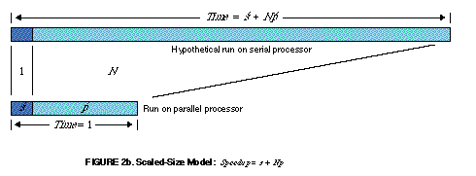
The computation time is constant
(instead of the problem size) increasing number of CPUs → solve bigger problem and get better results in the same time.
http://www.scl.ameslab.gov/Publications/Gus/AmdahlsLaw/Amdahls.html
Benner, R.E., Gustafson, J.L., and Montry, G.R., Development and analysis of scientific application programs on a 1024-processor hypercube," SAND 88-0317, Sandia National Laboratories, Feb. 1988.

Slide 34
Amdahl’s – fixed problem size (different run time)
Gustafson’s – fixed run time (different problem size)

Slide 35
Computation/Communication Ratio
Notes:
Maximize this number. Reduce communication overhead. Relevant in domain decomposition

Slide 36
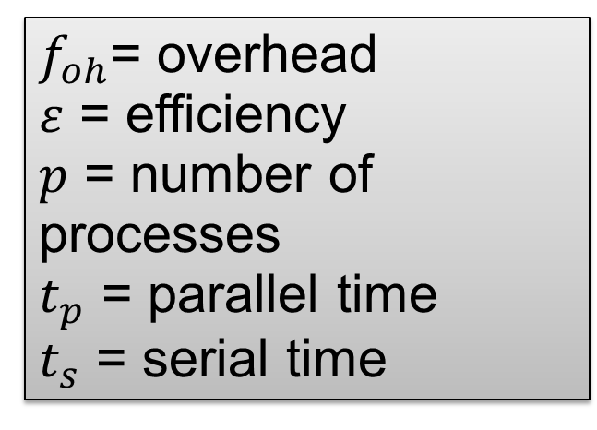
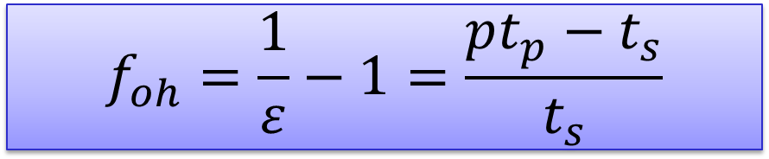
Overhead
$$f_{oh}=\frac{1}{ε}−1=\frac{pt_{p}−t_{s}}{t_{s}}$$
$f_{oh}$= overhead
$ε$ = efficiency
$p$ = number of processes
$t_{p}$ = parallel time
$t_{s}$ = serial time

Slide 37
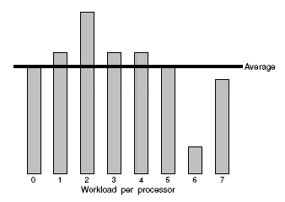

Load Imbalance
Static / Dynamic

Slide 38
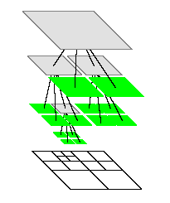
Dynamic Partitioning – Domain Decomposition by Quad or Oct Trees

Slide 39
Motivation
Basic terms
Parallelization Methods
Examples
Profiling, Benchmarking and Performance Tuning
Common H/W
Supercomputers
HTC and Condor
The Grid
Future trends

Slide 40
Methods of Parallelization
Message Passing (PVM, MPI)‏
Shared Memory (OpenMP)‏
Hybrid
PGAS (Global Arrays)
----------------------
Network Topology

Slide 41
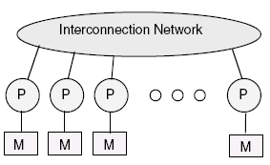
Message Passing (MIMD)‏

Slide 42





The Most Popular Message Passing APIs
PVM – Parallel Virtual Machine (ORNL)‏
MPI – Message Passing Interface (ANL)‏
  Free SDKs for MPI: MPICH and LAM
  New: OpenMPI (FT-MPI,LAM,LANL)‏

Slide 43
MPI
Standardized, with process to keep it evolving.
Available on almost all parallel systems (free MPICH
used on many clusters), with interfaces for C and
Fortran.
Supplies many communication variations and optimized
functions for a wide range of needs.
Supports large program development and integration of
multiple modules.
Many powerful packages and tools based on MPI.
While MPI large (125 functions), usually need very few
functions, giving gentle learning curve.
Various training materials, tools and aids for MPI.

Slide 44
MPI Basics
MPI_SEND() to send data
MPI_RECV() to receive it.
--------------------
MPI_Init(&argc, &argv)‏
MPI_Comm_rank(MPI_COMM_WORLD, &my_rank)‏
MPI_Comm_size(MPI_COMM_WORLD,&num_processors)‏
MPI_Finalize()‏

Slide 45
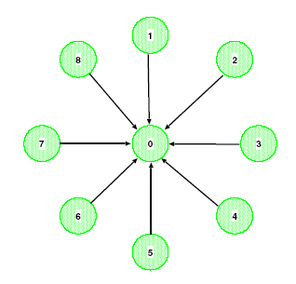
A Basic Program
initialize
if (my_rank == 0){
sum = 0.0;
for (source=1; source<num_procs; source++){
MPI_RECV(&value,1,MPI_FLOAT,source,tag,
MPI_COMM_WORLD,&status);
sum += value;
}
} else {
MPI_SEND(&value,1,MPI_FLOAT,0,tag,
MPI_COMM_WORLD);
}
finalize

Slide 46
MPI – Cont’
Deadlocks
Collective Communication
MPI-2:
  Parallel I/O
  One-Sided Communication

Slide 47
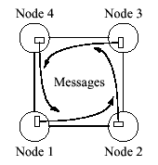

Be Careful of Deadlocks
M.C. Escher’s Drawing Hands
Un Safe SEND/RECV
Notes:
For examples, all nodes hold on RECV!

Slide 48
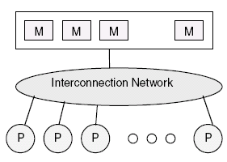
Shared Memory ‏

Slide 49
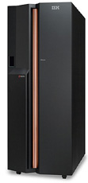
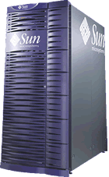

Shared Memory Computers
→IBM p690+
  Each node: 32 POWER 4+ 1.7 GHz processors
←Sun Fire 6800 900Mhz UltraSparc III processors
נציגה כחול-לבן
Notes:
Reference: m11notes from SC04

Slide 50

OpenMP

Slide 51
An OpenMP Example
#include <omp.h>
#include <stdio.h>
int main(int argc, char* argv[])‏
{
printf("Hello parallel world from thread:\n");
#pragma omp parallel
{
printf("%d\n", omp_get_thread_num());
}
printf("Back to the sequential world\n");
}
~> export OMP_NUM_THREADS=4
~> ./a.out
Hello parallel world from thread:
1
3
0
2
Back to sequential world
~>

Slide 52
Partitioned Global Address Space (PGAS)
ZPL
Unified Parallel C (UPC)
Titanium (Java)
Co Array Fortran → Fortran2008
DARPA HPCS
  Chapel (Cray)
  X10 (IBM)
  Fortress (Sun→Oracle), closed
Hiding the message passing complexity.
Splitting the scientific algorithm from the computer science implementation
Still under development
HPCS=High Productivity Computing Systems

Slide 53
Constellation systems
P
P
P
P
P
P
P
P
P
P
P
P
C
C
C
C
C
C
C
C
C
C
C
C
M
M
M
Interconnect

Slide 54
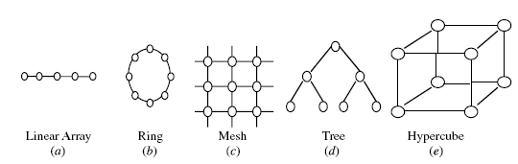
Network Topology

Slide 55
Network Properties
Bisection Width - # links to be cut in order to divide the network into two equal parts
Diameter – The max. distance between any two nodes
Connectivity – Multiplicity of paths between any two nodes
Cost – Total Number of links

Slide 56
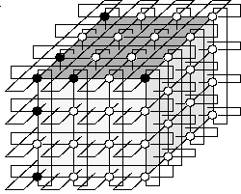
3D Torus

Slide 57

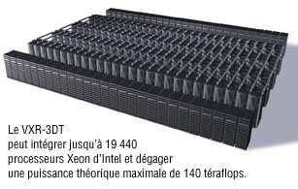
Ciara VXR-3DT
Notes:
100% commodity Linux cluster delivered and supported by leading industry veterans
Unique Linux cluster architecture with dual-rail12x InfiniBand distributed fabric
InfiniBand natively attached RAID storage
No single point of failure anywhere in system
Processor per Rack.........................................................160
Initial Processor Speed (GHz)..........................................3.6
Type of Memory.............................................................DDR2 400 ECC/Reg
Memory per CPU............................................................16 GBytes
Total CPUs....................................................................19,440
Total Memory................................................................311 TBytes
Total Storage Capacity (Max. I/O BW)..............................650 TBytes
Compute Rack (Max.)....................................................132
System Performance Linpak Rmax (TFlop/s).....................140
System Performance Estimated Linpak Rpeak (TFlop/s).....108
Maximum I/O Bandwidth (1300 I/O Ports)........................2.6 TBytes/s
Maximum Fabric Bandwidth (18x15x18)...........................3.9 TBytes/s
Surface for Compute System (Square/feet)......................2,240

Slide 58
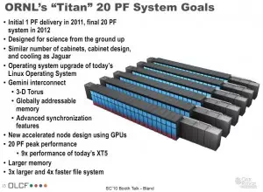
Titan 20 Petaflops at Oak Ridge National Lab

Slide 59
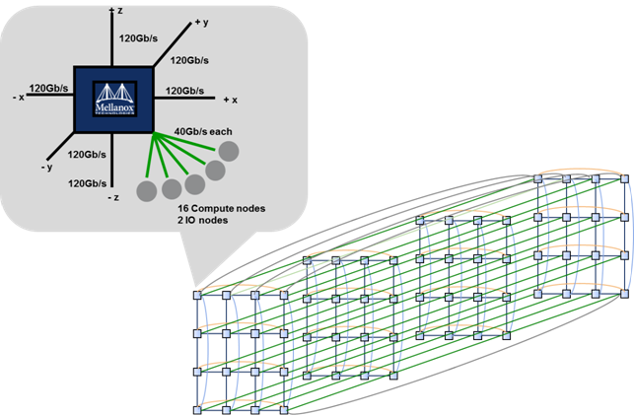
SDSC Gordon Supercomputer
4x4x4 3D-Torus Logical Deployment Diagram

Slide 60
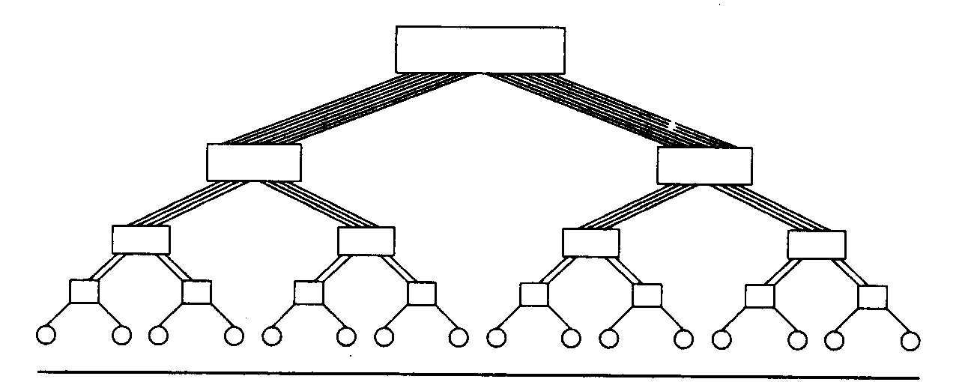
A Binary
Fat tree: Thinking Machine CM5, 1993

Slide 61
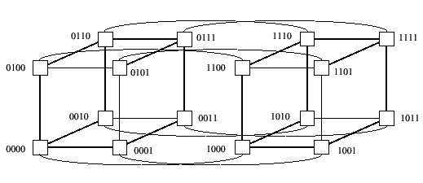
4D Hypercube Network

Slide 62
Motivation
Basic terms
Methods of Parallelization
Examples
Profiling, Benchmarking and Performance Tuning
Common H/W
Supercomputers
HTC and Condor
The Grid
Future trends

Slide 63
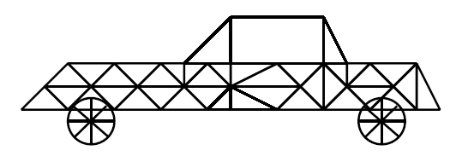
Example #1
The car of the future
Reference: SC04 S2: Parallel Computing 101 tutorial

Slide 64
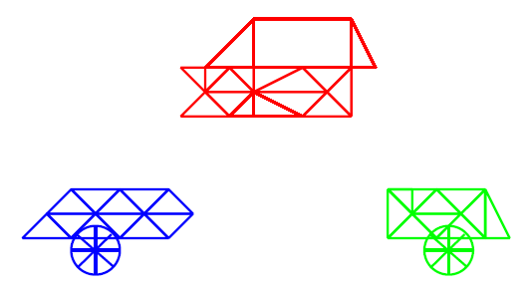
A Distributed Car

Slide 65
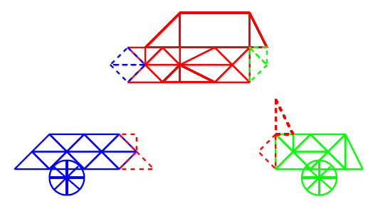
Halos

Slide 66
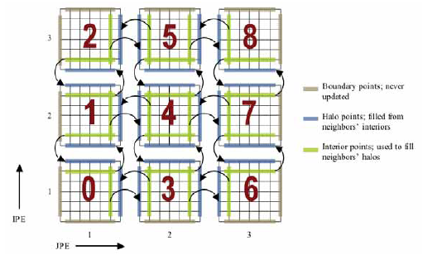
Ghost points
Notes:
Ref: v14n4.pdf in work21 folder

Slide 67
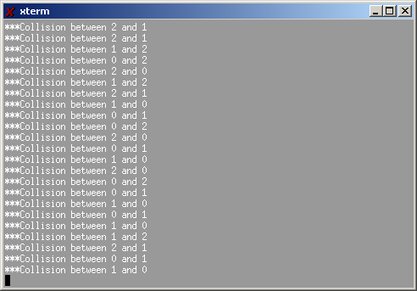
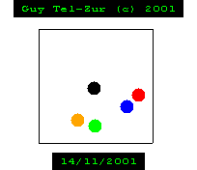
Example #2:
Collisions of Billiard Balls
MPI Parallel Code
MPE library is used for the real-time graphics
Each process is responsible to a single ball

Slide 68
Example #3: Parallel Pattern Recognition
The Hough Transform
P.V.C. Hough. Methods and means for recognizing complex patterns.
U.S. Patent 3069654, 1962.

Slide 69
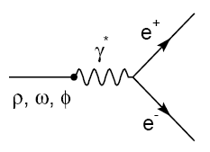
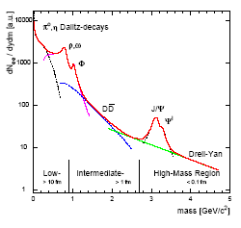
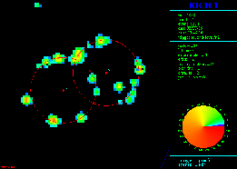
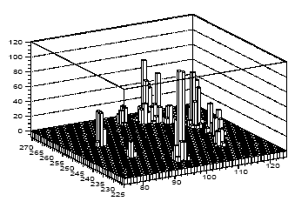
Guy Tel-Zur, Ph.D. Thesis. Weizmann Institute 1996

Slide 70
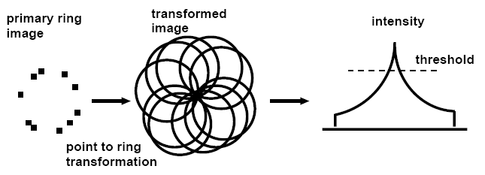
Ring candidate search by a Hough transformation

Slide 71
Parallel Patterns
Master / Workers paradigm
Domain decomposition: Divide the image into slices. Allocate each slice to a process

Slide 72
Motivation
Basic terms
Methods of Parallelization
Examples
Profiling, Benchmarking and Performance Tuning
Common H/W
Supercomputers
HTC and Condor
The Grid
Future trends

Slide 73
Profiling, Benchmarking and Performance Tuning
Profiling: Post mortem analysis
Benchmarking suite: The HPC Challenge
PAPI, http://icl.cs.utk.edu/papi/
By Intel (will be installed at the BGU)
  Vtune
  Parallel Studio
Paraprof
Scalasca
Tau…

Slide 74
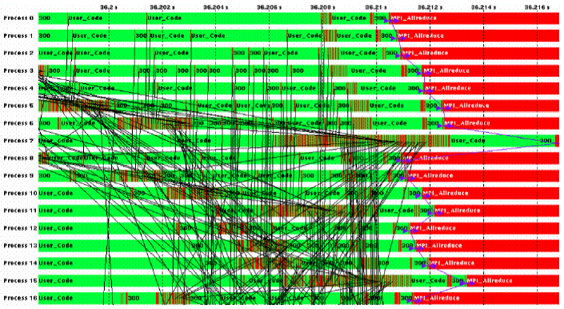
Profiling

Slide 75
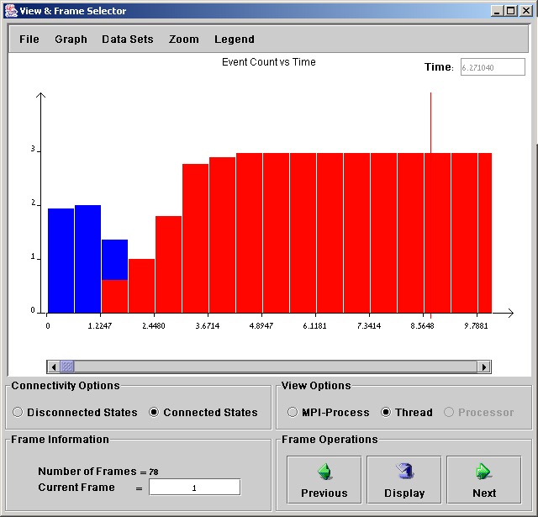
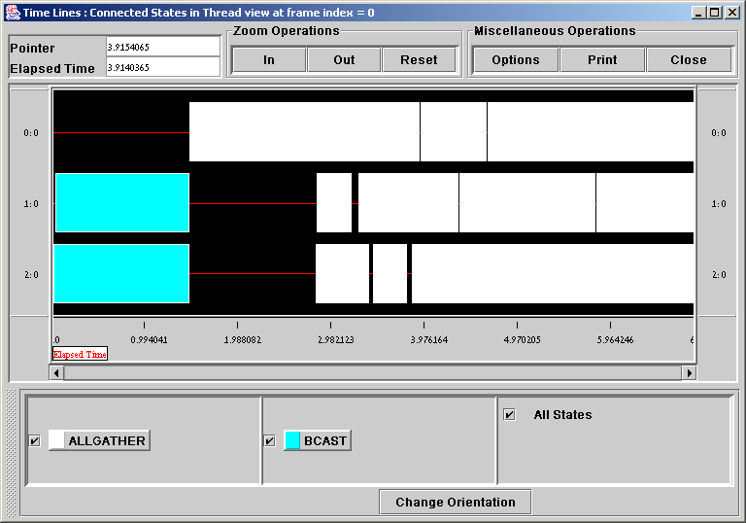
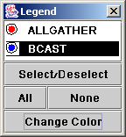
Profiling
MPICH: Java based Jumpshot3
Notes:
There exist several graphic tools for profiling parallel tasks. However, interpretation of these plots is not always simple. MPICH: Upshot (Tcl/Tk)/ Jumpshot3 (Java). LAM: xmpi. Commercial tool: Vampir (Pallas).

Slide 76

PVM Cluster view with XPVM

Slide 77

Cluster Monitoring

Slide 78


Slide 79

Diagnostics
Microway – Link Checker

Slide 80
Why Performance Modelling?
Parallel performance is a multidimensional space:
– Resource parameters: # of processors, computation speed,
network size/topology/protocols/etc., communication speed
– User-oriented parameters: Problem size, application input,
target optimization (time vs. size)‏
– These issues interact and trade off with each other
Large cost for development, deployment and
maintenance of both machines and codes
Need to know in advance how a given application
utilizes the machine’s resources.
Notes:
Ref: SC04 , m5 notes

Slide 81
Performance Modelling
Basic approach:
Trun = Tcomputation + Tcommunication – Toverlap
Trun = f (T1,#CPUs , Scalability)‏

Slide 82
HPC Challenge
HPL - the Linpack TPP benchmark which measures the floating point rate of execution for solving a linear system of equations.
DGEMM - measures the floating point rate of execution of double precision real matrix-matrix multiplication.
STREAM - a simple synthetic benchmark program that measures sustainable memory bandwidth (in GB/s) and the corresponding computation rate for simple vector kernel.
PTRANS (parallel matrix transpose) - exercises the communications where pairs of processors communicate with each other simultaneously. It is a useful test of the total communications capacity of the network.
RandomAccess - measures the rate of integer random updates of memory (GUPS).
FFTE - measures the floating point rate of execution of double precision complex one-dimensional Discrete Fourier Transform (DFT).
Communication bandwidth and latency - a set of tests to measure latency and bandwidth of a number of simultaneous communication patterns; based on b_eff (effective bandwidth benchmark).
Notes:
Ref: m2 tutorial from SC04

Slide 83
Bottlenecks
A rule of thumb that often applies
A contemporary processor, for a
spectrum of applications, delivers (i.e.,sustains) 10% of peak performance

Slide 84
Processor-Memory Gap
1000
CPU
100
Performance
10
DRAM
1
1980
1982
1984
1986
1988
1990
1992
1994
1996
1998
2000

Slide 85
Memory Access Speed on a DEC 21164 Alpha
  Registers 2 ns
  LI On-Chip 4 ns; ~kB
  L2 On-Chip 5 ns; ~MB
  L3 Off-Chip 30ns
  Memory 220ns; ~GB
  Hard Disk 10ms; ~+100GB

Slide 86
Motivation
Basic terms
Methods of Parallelization
Examples
Profiling, Benchmarking and Performance Tuning
Common H/W
Supercomputers
HTC and Condor
The Grid
Future trends

Slide 87

Common H/W
Clusters
  Pizzas
  Blades
  GPGPUs

Slide 88



“Pizzas”
Tatung Dual Opteron
Tyan 2881 dual Opteron board

Slide 89

Blades
4U, holding up to 8 server blades.
dual XEON/XEON w/z EM64T/Opteron
PCI-X, built-in KVM switch and GbE/FE switch, hot swappable 6+1 redundant power
Notes:
Compact, 4U 19" rackmount chassis High density, holding up to 8 server blades in 4U chassis High performance, run dual XEON/XEON w/z EM64T/Opteron, up to 8GB memory, dual onboard storage Off-the-shelf expansion, using standard PCI-X addon card to expand I/O and connectivity Highly integration, built-in KVM switch and GbE/FE switch, CDROM/FDD peripheral,(optional combo drive or DVDROM) Versatile network connectivity, support feedthru ports for full bandwidth, or switched ports for cable consolidation, support copper interface and fibre interface Friendly to use, support KVM console and Serial console, and CDROM/FDD accessEasy to manage, support remote server control and monitoring Self maintenance, hot swappable modular design, very low skill to sustain the system Reliable and high availability, hot swappable 6+1 redundant power, max 2100W capacity, hot swappable redundant cooling FAN

Slide 90

GPGPU

Slide 91


Slide 92




Top of the line Networking
Mellanox Infiniband
  Server to Server 40Gps (QDR)
  Switch to Switch:60Gbps
  ~1micro-second latency
Bandwidth

Slide 93

IS5600 - 648-port 20 and 40Gb/s InfiniBand Chassis Switch

Slide 94
Motivation
Basic terms
Methods of Parallelization
Examples
Profiling, Benchmarking and Performance Tuning
Common H/W
Supercomputers
HTC and Condor
The Grid
Future trends

Slide 95
Supercomputers
The Top 10
The Top 500
Trends (will be covered while SCxx conference – Autumn semester OR ISCxx – Spring semester)
“An extremely high power computer that has a large amount of main memory and very fast processors…
Often the processors run in parallel.”

Slide 96

The
Do-It-Yourself Supercomputer
Scientific American, August 2001 Issue
also available online:
http://www.sciam.com/2001/0801issue/0801hargrove.html

Slide 97



The Top500

Slide 98

The Top15
Top 15 June 2009

Slide 99


Slide 100


IBM Blue Gene

Slide 101

Cray XE6 cabinets: | >235
Cray XK6 cabinets: | >30
Total cabinets, including storage and server cabinets: | >300
Compute nodes: | >25,000
Usable storage bandwidth: | >1 TB/s
Aggregate system memory: | >1.5 PB
Memory per core: | 4 GB
Gemini network cables: | Over 9,000 (~4,500km of single wires)
Interconnect topology: | 3D Torus
Number of disks: | >17,000
Number of memory DIMMS: | >190,000
Usable storage: | >25 PB
Peak performance: | >11.5 PF
Number of AMD processors: | >49,000
Number of AMD x86 cores: | >380,000
Number of NVIDIA GPUs: | >3,000
External network bandwidth: | 100 Gb/s scaling to 300 Gb/s
Integrated Near Line Environment: | Scaling to 500 petabytes
Bandwidth to near-line storage: | 100 GB/s
Notes:
http://www.ncsa.illinois.edu/BlueWaters/system.html

Slide 102

Barcelona Supercomputer Centre
Notes:
4.564 PowerPC 970 FX processors
• 2282 2-way nodes
9 TB of Memory
• 4 GB per node
231 TB Storage Capacity
3 networks
• Myrinet
• Gigabit
• 10/100 Ethernet
Operating System: Linux
• Linux kernel version 2.6

Slide 103

4.564 PowerPC 970 FX processors, 9 TB of Memory, 4 GB per node, 231 TB Storage Capacity.
3 networks: • Myrinet • Gigabit • 10/100 Ethernet
• OS: Linux kernel version 2.6

Slide 104

Virginia Tech
1100 Dual 2.3 GHz Apple XServe/Mellanox Infiniband 4X/Cisco GigE
http://www.tcf.vt.edu/systemX.html

Slide 105

Source: SciDAC Review, Number 16, 2010

Slide 106
Top 500 List
Being published twice a year.
Spring Semester: ISC, Germany
Autumn Semester: SC, USA
We will cover these events in our course!

Slide 107
Motivation
Basic terms
Methods of Parallelization
Examples
Profiling, Benchmarking and Performance Tuning
Common H/W
Supercomputers
HTC and Condor
The Grid
Future trends

Slide 108
HTC and Condor
High-Performance Computing
High-Throughput Computing
HTC vs.HPC
Condor
Condor at the BGU

Slide 109
High Throughput Computing
For many experimental scientists, scientific progress and quality of research are strongly linked to computing throughput. In other words, they are less concerned about instantaneous computing power. Instead, what matters to them is the amount of computing they can harness over a month or a year --- they measure computing power in units of scenarios per day, wind patterns per week, instructions sets per month, or crystal configurations per year.

Slide 110
HTC vs. HPC
FLOPS vs. FLOPY
FLOPY ≠ (60*60*24*7*52)*FLOPS

Slide 111

Condor
Opportunistic environment
Batch scheduling
ClassAds and Match Making
Master – Workers

Slide 112


Condor at the BGU
Nearly 200 processors belong to the pool from pubic students labs

Slide 113


Slide 114

Condor at Micron
8000+ processors in 11 “pools”
Linux, Solaris, Windows
<50th Top500 Rank
3+ TeraFLOPS
Centralized governance
Distributed management
16+ applications
Self developed
Micron’s Global Grid

Slide 115
Motivation
Basic terms
Methods of Parallelization
Examples
Profiling, Benchmarking and Performance Tuning
Common H/W
Supercomputers
HTC and Condor
The Grid
Future trends

Slide 116
The Grid
{SETI, Einsterin…}@home
The Grid vision
CERN needs for computing resources

Slide 117

SETI@home

Slide 118


Slide 119


Einstein at Home
http://einstein.phys.uwm.edu/

Slide 120



The Grid
Carl Kesselman &
Ian Foster

Slide 121

The Grid
MIT Technology Review:
10 Emerging Technologies That Will Change the World
February 2003
…Technology Review identifies the developments that will dramatically affect the way we live and work—and profiles the leading innovators behind them…
http://www.technologyreview.com/articles/emerging0203.asp

Slide 122

The Grid Vision
Grid technologies make it possible for geographically distributed teams to share a wide variety of resources. across geographically distributed teams.

Slide 123

Imagine being able to plug your computer into the wall and tapping into as much processing power as you need.

Slide 124


LHC Grid Computing
Large Hadron Collider: particle accelerator consisting of a 27 Km ring of superconducting magnets in a tunnel about 120 m under ground
- Energy of each LHC beam: 7 Tera-electron-volts
Data accumulation rate: 10 Petabytes per year (equivalent to about 20 million CD-ROMs).
- CPU power required: Equivalent to about 100 thousand of today’s PCs
- Local Area Network throughput: approaching a Terabit per second at dozens of sites.
- Wide Area Network capacity: many Gigabits per second to hundreds of sites.
- Number of scientists working on LHC worldwide: about 10 000
- Number of institutes involved in LHC: about 1000
- Number of countries around the world with LHC scientists: over 50

Slide 125

LHC Data
Balloon
(30 Km)‏
CD stack with
1 year LHC data!
(~ 20 Km)‏
40 million collisions per second
After filtering, 100 collisions of interest
per second
A Megabyte of data for each collision
= recording rate of 0.1 Gigabytes/sec
10¹⁰ collisions recorded each year
~ 10 Petabytes/year of data
LHC data correspond to about
20 million CDs each year!
~ 100,000 of
today's fastest
PC processors
Concorde
(15 Km)‏
Mt. Blanc
(4.8 Km)‏

Slide 126


Slide 127

MonALISA

Slide 128


Slide 129
Motivation
Basic terms
Methods of Parallelization
Examples
Profiling, Benchmarking and Performance Tuning
Common H/W
Supercomputers
HTC and Condor
The Grid
Cloud Computing
Future trends

Slide 130
Cloud Computing
Guest Lecture
Demo
Advanced Course in Parallel Computing
  Hopefully will be given next year.

Slide 131


Technology Trends - Processors

Slide 132


Slide 133
Moore’s Law Still Holds
10
11
2G
4G
10
10
512M
1G
10
9
Memory
256M
Microprocessor
128M
Itanium®
10
8
64M
Pentium® 4
16M
10
7
4M
Pentium® III
1M
Pentium® II
10
6
256K
Pentium®
Transistors Per Die
64K
i486™
10
5
16K
i386™
4K
80286
10
4
1K
8080
10
3
8086
4004
10
2
10
1
10
0
’
60
’
65
’
70
’
75
’
80
’
85
’
90
’
95
’
00
’
05
’
10
Source: Intel

Slide 134

(Very near) Future trends

Slide 135


1997 Prediction

Slide 136


Slide 137
Power dissipation
Opteron dual core 95W
Human Activities
  Sleeping 81W
  Sitting 93W
  Conversation 128W
  Strolling 163W
  Hiking 407W
  Sprinting 1630W
Notes:
Strolling – לטייל,לשוטט

Slide 138

Power Consumption Trends in Microprocessors
Notes:
Slide from POWER DEMANDS IN HIGH-END MICROPROCESSORS from Prismak company.
power consumption to increase by a factor of a little more than 2X every four years.
Power=(Total Capacitance x Frequency x Voltage²) /2. http://www.transmeta.com/. The Crusoe processor.

Slide 139

The Power Problem

Slide 140


Managing the Heat Load
Liquid cooling system in Apple G5s
Heat sinks in 6XX series Pentium 4s
Source: Thom H. Dunning, Jr.
National Center for Supercomputing Applications
and Department of Chemistry
University of Illinois at Urbana-Champaign

Slide 141

Dual core (2005)

Slide 142


2009
AMD Istanbul 6 cores:

Slide 143



2009/10 - Nvida - Fermi
512 cores

Slide 144

System on a Chip
Source: scidac review, number 16, 2010

Slide 145
Top 500 – Trends Since 1993

Slide 146


Slide 147


Slide 148


Slide 149


Slide 150

Processor Count

Slide 151

6/2011

Slide 152

6/2011

Slide 153
Price / Performance
$0.30/MFLOPS (was $0.60 two years ago)‏
$300/GFLOPS
$300,000/TFLOPS
$30,000,000 for #1
ירידת מחירים מתמדת.
אי אפשר לעדכן את השקפים ☺
2009: US$0.1/hour/core on Amazon EC2
2010: US$0.085/hour/core on Amazon EC2

Slide 154

The Dream Machine - 2005
Quad dual core
Notes:
Quad dual core AMD opteron by Alpro: Quad AMD Opteron™ processors
Support for Dual-Core AMD Opteron Processors
Supports up to 32GB in 16 DIMM Sockets of DDR333/400 ECC registered memory
Up to 600GB IDE, SATA or 292GB SCSI
Up to 2 removable HDDs
PCI-X or PCI-Express support
Two on-board Gigabit ports
On-board video
Integrated slim FDD and CD or DVD ROM
Tool-less access to chassis, memory, HDDs, PCI card, blowers, and power supply
custom slim 600W PS (upgrade to 700W PS in Q4/04)
Integrated bi-directional slide rails
1U EIA-standard 19" Rackmount Server
Assume $16K, for 2x8=16GFLOPS (peak) → $1000/GFLOP
Dual dual-core $5000/8GFLOPS = $625/GFLOPS

Slide 155

The Dream Machine - 2009
32 cores
Supermicro 2U Twin² Servers – 8 X 4-cores processors
375 GFLOPS/kW

Slide 156


The Dream Machine 2010
AMD 12 cores (16 cores in 2011)

Slide 157

The Dream Machine 2010
Supermicro - Double-Density TwinBlade™
20 DP Servers in 7U, 120 Servers in 42U, 240 sockets-> 6 cores/cpu = 1,440 cores/rack
Peak:1440*4ops*2GHz=11TF

Slide 158
Multi-core→ Many cores
Higher performance per watt
Directly connects the processor cores to a single die to even further reduce latencies between processors
Licensing per socket?
A short online flash clip from AMD

Slide 159
Another Example: The Cell
By Sony,Toshiba and IBM
Observed clock speed: > 4 GHz
Peak performance (single precision): > 256 GFlops
Peak performance (double precision): >26 GFlops
Local storage size per SPU: 256KB
Area: 221 mm²
Technology 90nm
Total number of transistors: 234M

Slide 160
The Cell (cont’)‏
A heterogeneous chip multiprocessor consisting of a 64-bit Power core, augmented with 8 specialized co-processors based on a novel single-instruction multiple-data (SIMD) architecture called SPU (Synergistic Processor Unit), for data intensive processing as is found in cryptography, media and scientific applications. The system is integrated by a coherent on-chip bus.
Ref: http://www.research.ibm.com/cell

Slide 161

The Cell (Cont’)‏

Slide 162
Virtualization
Virtualization—the use of software to allow workloads to
be shared at the processor level by providing the illusion of
multiple processors—is growing in popularity.
Virtualization balances workloads between underused IT
assets, minimizing the requirement to have performance
overhead held in reserve for peak situations and the need
to manage unnecessary hardware.
Xen….
Our Educational Cluster is based on this technology!!!

Slide 163

Mobile Distributed Computing

Slide 164
Summary

Slide 165
References
Gordon Moore http://www.intel.com/technology/mooreslaw/index.htm
Moore’s Law :
  ftp://download.intel.com/museum/Moores_Law/Printed_Materials/Moores_Law_Backgrounder.pdf
  http://www.intel.com/technology/silicon/mooreslaw/index.htm
Future processors trends: ftp://download.intel.com/technology/computing/archinnov/platform2015/download/Platform_2015.pdf

Slide 166
References
My Parallel Processing Course website http://www.ee.bgu.ac.il/~tel-zur/2011A
“Parallel Computing 101”, SC04, S2 Tutorial
HPC Challenge: http://icl.cs.utk.edu/hpcc
Condor at the Ben-Gurion University:
http://www.ee.bgu.ac.il/~tel-zur/condor

Slide 167
References
MPI: http://www-unix.mcs.anl.gov/mpi/index.html
Mosix: http://www.mosix.org
Condor:http://www.cs.wisc.edu/condor
The Top500 Supercomputers: http://www.top500.org
Grid Computing: Grid Café: http://gridcafe.web.cern.ch/gridcafe/
Grid in Israel:
  Israel Academic Grid: http://iag.iucc.ac.il/
  The IGT: http://www.grid.org.il/
Mellanox: http://www.mellanox.com/

Slide 168
Nexcom blades: http://bladeserver.nexcom.com.tw

Slide 169

References
Books: http://www.top500.org/main/Books/
The Sourcebook of Parallel Computing

Slide 170







References (a very partial list)
More books at the course website‏

